Slide 1




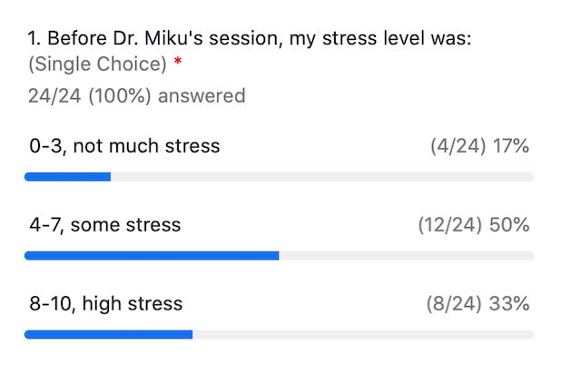
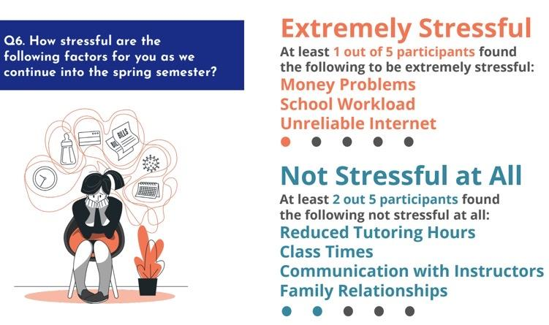
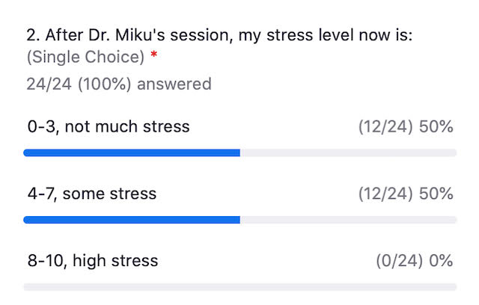
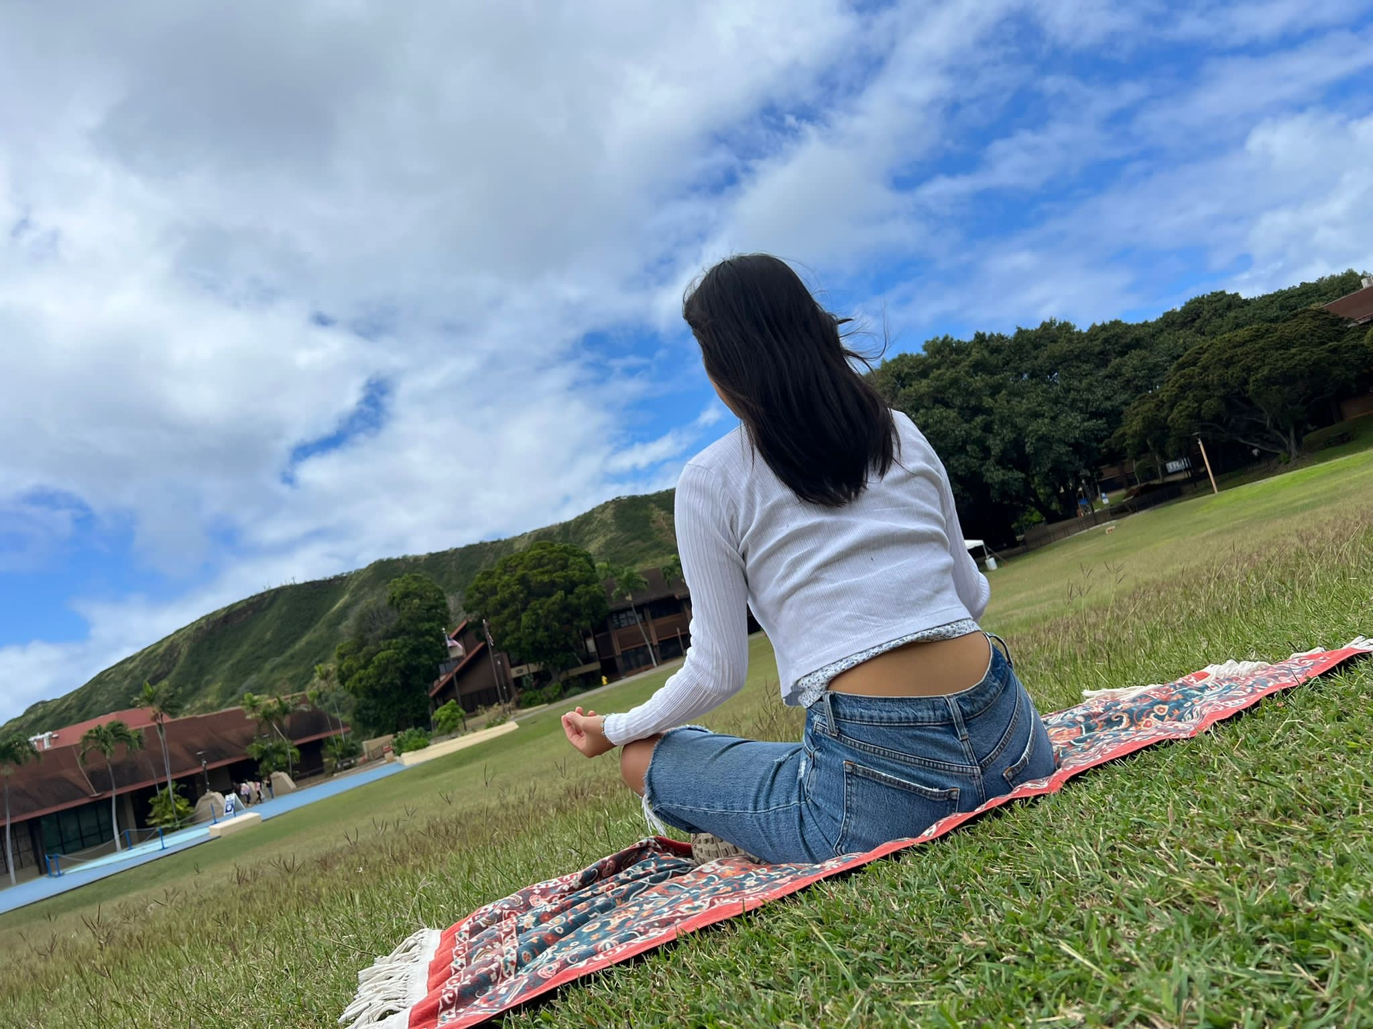
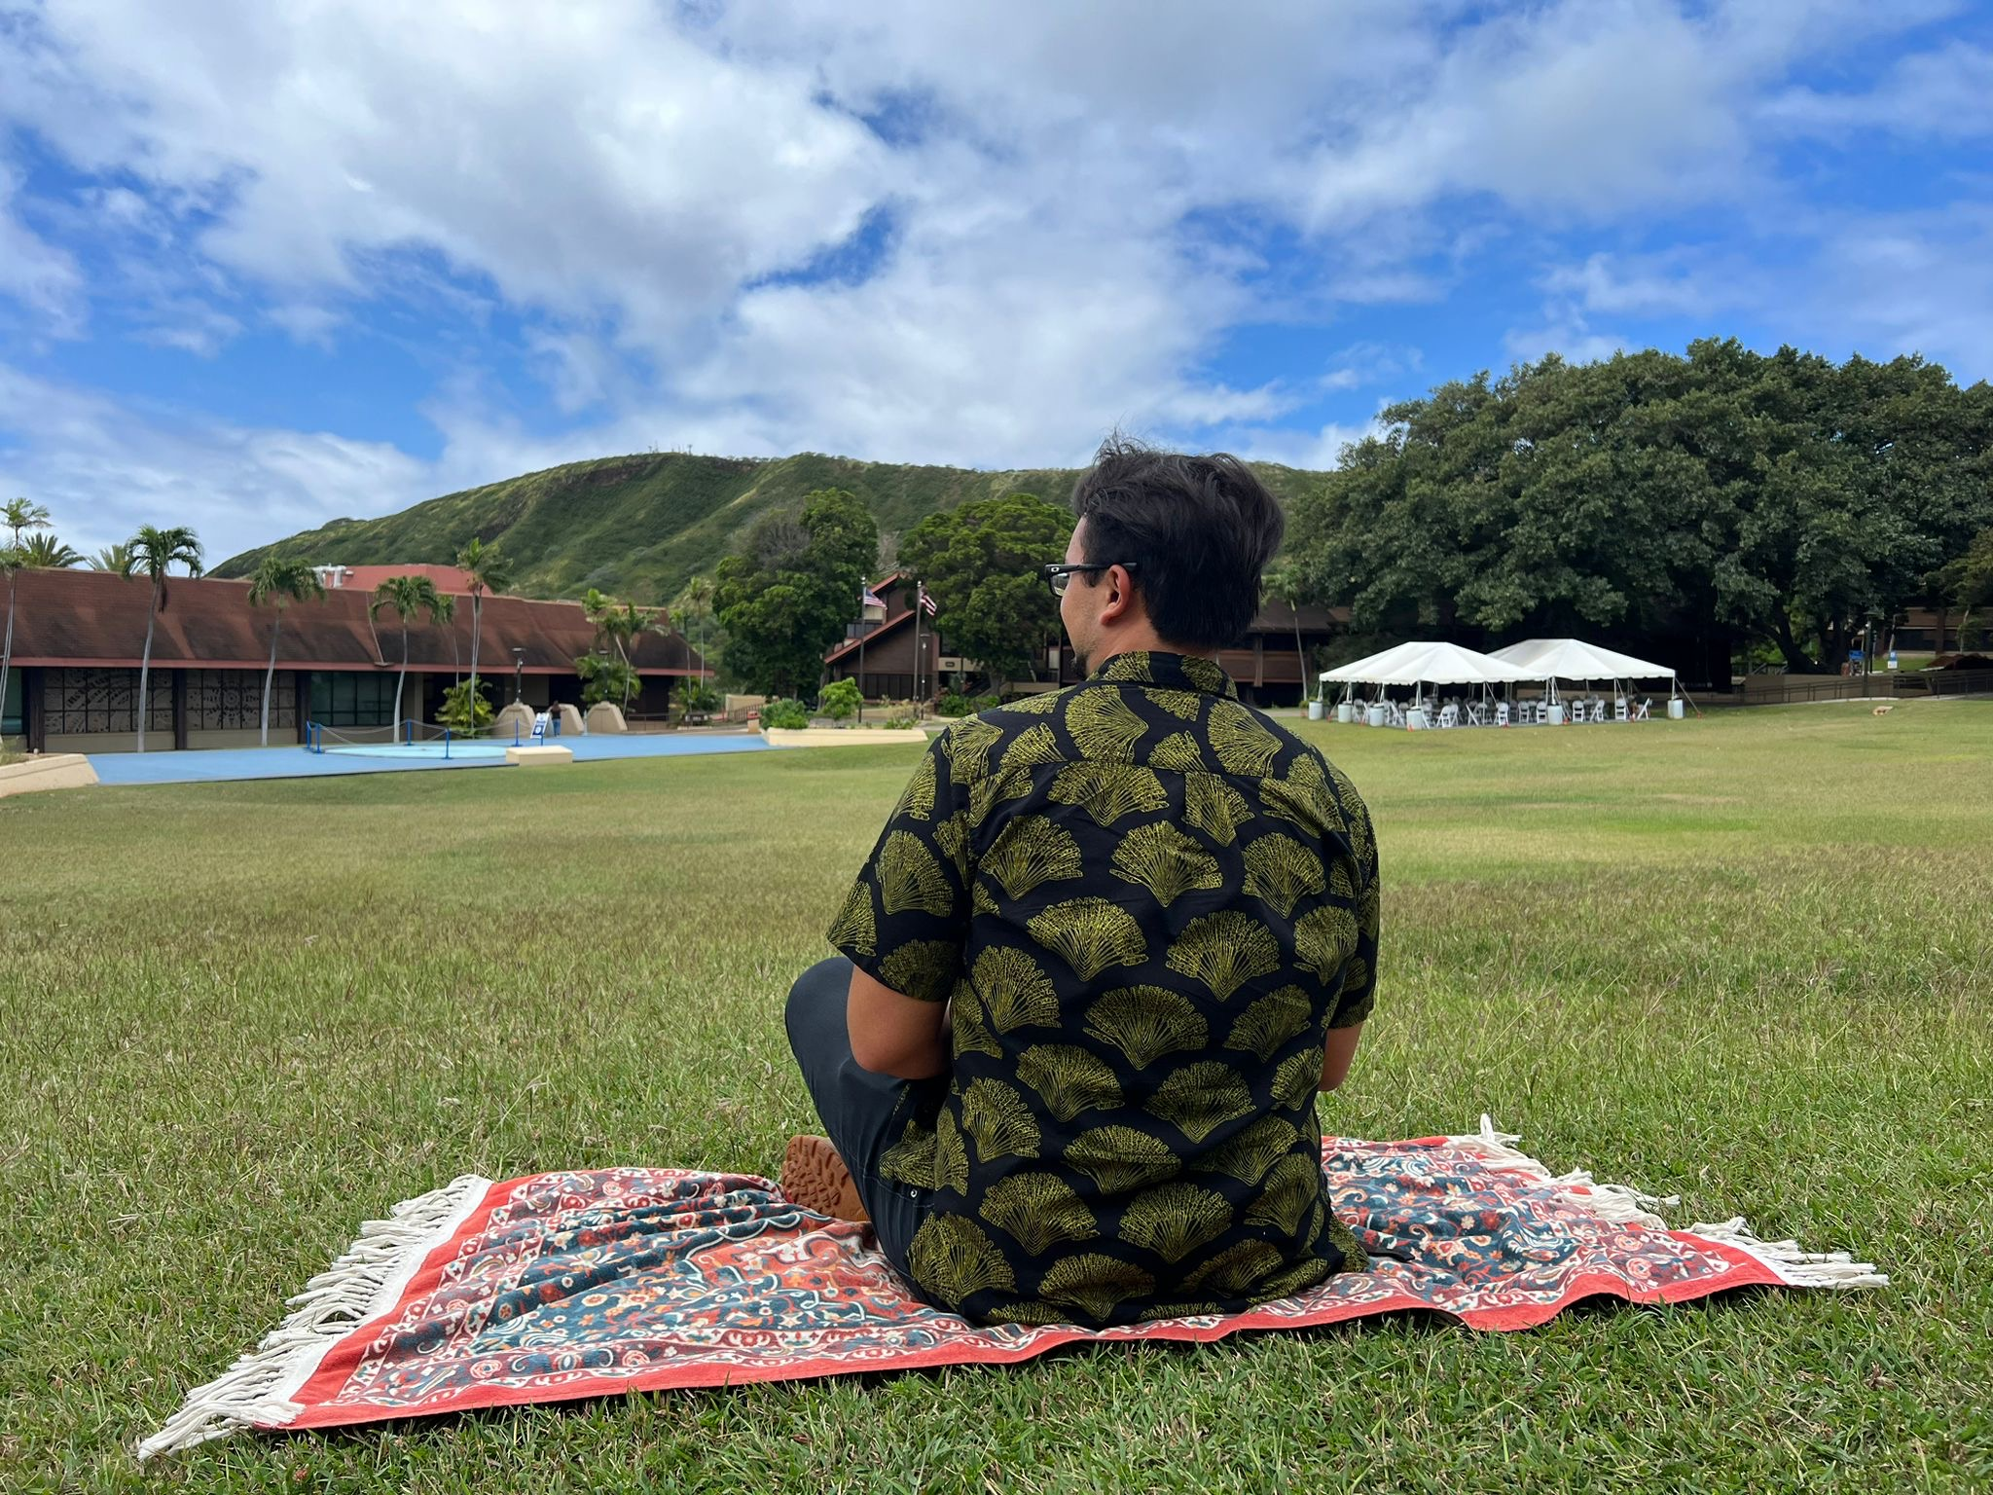
Mental Health & Wellness Case Study
Micah Tutuvanu
Resilience Corps Leaders Award Program, CERENE, Student Congress, Kapiʻolani Community College, Dr. Miku Lenentine
Background
Resilience is defined as the ability to withstand or recover from difficulties quickly. Typically when people ponder on what resilience is they think about resources etc. however resilience can be looked at in the sense of student life.
Student Congress surveys students on an annual basis known as the Student Congress annual spring survey. In the survey, a recurring theme was stressors.
How can the students create a resilient student life? Being resilient from the stressors of everyday life?
Preliminary Findings
Purpose
1 in 5 students are stressed with money problems, school workload and unreliable internet out of all 506 respondents that year
Mental health is #4 in leading issue mentioned in the Student Congress Snack & Chat
Dr. Miku mental health and wellness event benefited the students at Kapi’olani Community College and helped them de-stress. Statistics mention at the end of the session the students experienced no stress
Student/campus engagement is the best way to approach mental health and wellness
Figure 1.1 & 1.2 - Students stress level before Dr. Miku mental health and wellness event and after the event.
To combat mental health struggles encompassing student needs. Look into students who struggle with their mental health and solidify a mental health and wellness event to promote self care amongst the Kapiʻolani campus.
Research Methods
Student Congress Annual Spring Survey
Student Testimonies
Student Congress Snack & Chat
Mental Health & Wellness Event w/ Cerene
Future Hopes
Campus engagement is beneficial when assessing mental health and wellness
CERENE potentially creates a series of mental health and wellness meditation sessions with Dr. Miku with students taking the lead
Continue to utilize the Student Congress annual spring survey data to inform change
“Mental health is important because if I am not in the right mindset it provokes me to make unhealthy life choices“
Kapiʻolani Community College Student
Acknowledgements
The RCL Award Program is supported by a generous grant provided by the Hawaii Electric Company as well as State Farm. Weʻd also like to recognize Student Congress for their data in conducting this research.

