Slide 1
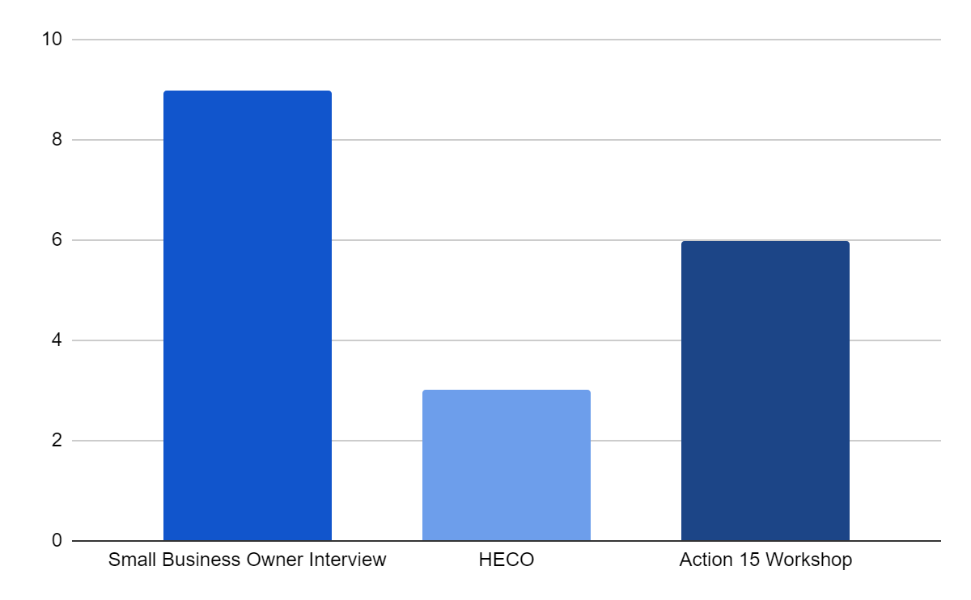
Exploring Economic Resilience on O’ahu:
A case study comparison of a small business and a corporation
Author: Rokaiya Rahman Reshmee, Faculty Advisor: Dr. Miku Lenentine
Resilience Corps Leaders Award Program, CERENE, Kapiʻolani Community College
Project Background
Proposed Methods
Action 15 Community Resilience Research is a continuation of the Ola Resilience Strategy for O”ahu created in 2019: https://resilientoahu.org/resilience-strategy. It is more focused on “Bouncing Forward” after natural disasters. The goal of this research is to identify 8-16 possible sites for Community Resilience Hubs in major planning areas of O’ahu. Community Resilience Hubs are community-led initiatives and are based on already existing organizations which provide support to their local communities. These Hubs are often run by an existing non-profit, operate in collaboration with local government and serve immediate and surrounding neighborhoods. They operate during blue skies and gray skies or during emergencies and offer essential services.
Research Methodology:
Thematic analysis,
Transcription AI,
Qualitative research methods
In-depth key informant interviews
Case Study
Expected Data Sources
Image 1. Example workshop focus group from the Ko’olauloa Region
Preliminary Findings
Introduction
Action 15 Hub Workshop
Interview with small business owner, particularly community minded / sustainability focused
Resilient and Renewable Energy Workshop - HECO
Conversation data
Focus group discussions
Key informant interviews
Examples of corporate resilience support:
Decarbonisation goals by 2045 - decarbonizing the energy system and make it more resilient in light of climate change.
Looking at the island in total, to create renewable energy, at very large volumes, a lot of renewable energy generation to feed, and serve, ultimately the entire island.
Introducing and implementing new solutions such as microgrids, hybrid microgrids and customer microgrids.
Examples of small business resilience support:
Develop resilience by collaborating and knowing where the support system are, knowing who is doing what, who are the neighbors and what they are upto, what people care about within that business block, in order to figure out who could provide necessary resources.
Making resilience a topic in discussions in existing meetings in the Business community, Business Association, networking opportunities, clubs and groups.
Providing classes and seminars to build skills where resilience conversations are made more common.
Being able to prepare mental health scene beforehand, incase disaster related events occur, in order to be able to respond quickly.
Other Examples:
Economic resilience: Efficient use of remaining resources at a given point in time to produce as much as possible.
The role of businesses in supporting economic resilience is by developing resilient communities against all hazards which requires leadership from government as well as businesses. Preparing the workforce, building safe facilities, investing in supplier relationships, and connecting to the community are all key pillars of true business community resilience – from the boardroom to the storefront.
The future generations will face the increasing challenges from climate change, instability, risk of pandemics and natural disasters. This will have significant impacts ranging from the global scale all the way down to our communities and local neighborhoods.
Purpose
The purpose of this research is to study the ways to increase economic resilience in the face of climate change challenges on O’ahu. The specific focus for this research project is the role of corporations as well as small businesses in addressing these challenges.
Research Importance
Research Question
Figure 1. Comparison of AI generated keyword count between a small business and a large energy corporation
The coronavirus crisis is an example which holds significant lessons that can help us address climate change if we make greater economic and environmental resiliency core to our planning for the recovery ahead. The scope and magnitude of this crisis and the long shadow it casted, it is vital to address if the world can afford to pay attention to climate change and the broader sustainability agenda at this time.
Not only does the climate action remain critical over the next decade, but investments in climate resilient infrastructure and the transition to a lower-carbon future can drive significant near-term job creation while increasing economic and environmental resiliency.
I believe that it is important that we understand these terms as they are popular concepts that are driving the goals of organizations across the globe. While sustainability looks at how current generations can meet their needs without compromising that ability for future generations, resilience considers a system’s ability to prepare for threats, absorb impacts, and to recover and adapt from disruptive events.
What is the role of corporations & small businesses in supporting community resilience?
How are corporations defining resilience vs small businesses?
“Having more collaboration between different businesses helps us become more resilient, because it makes us stronger, and has us consolidating resources and time and different things."
Small Business Owner
QR Link to
Citations
“Taking into account resilience and reliability, we have to make sure that at the end of the day, the lights stay on, and we look for opportunities to to improve resilience so that we can, you know, withstand these types of events that may occur.”
HECO
Acknowledgements
The RCL Award Program is supported by a generous grant provided by the Hawaii Electric Company as well as State Farm.
Notes:
Broad Question:
How can we as a society support greater resilience for our neighborhoods and communities in the face of climate change, global political instability, increasing risk of pandemics and natural disasters? (In the context of Action 15 : specifically focuses on resilience hubs as part of resilience planning).
How can we as a society support greater economic resilience for our neighborhoods and communities in the face of climate change, global political instability, increasing risk of pandemics and natural disasters?
Specific Topic Question:
[How do we as a society] What is the role of corporations & small businesses in supporting economic resilience?

