Slide 1
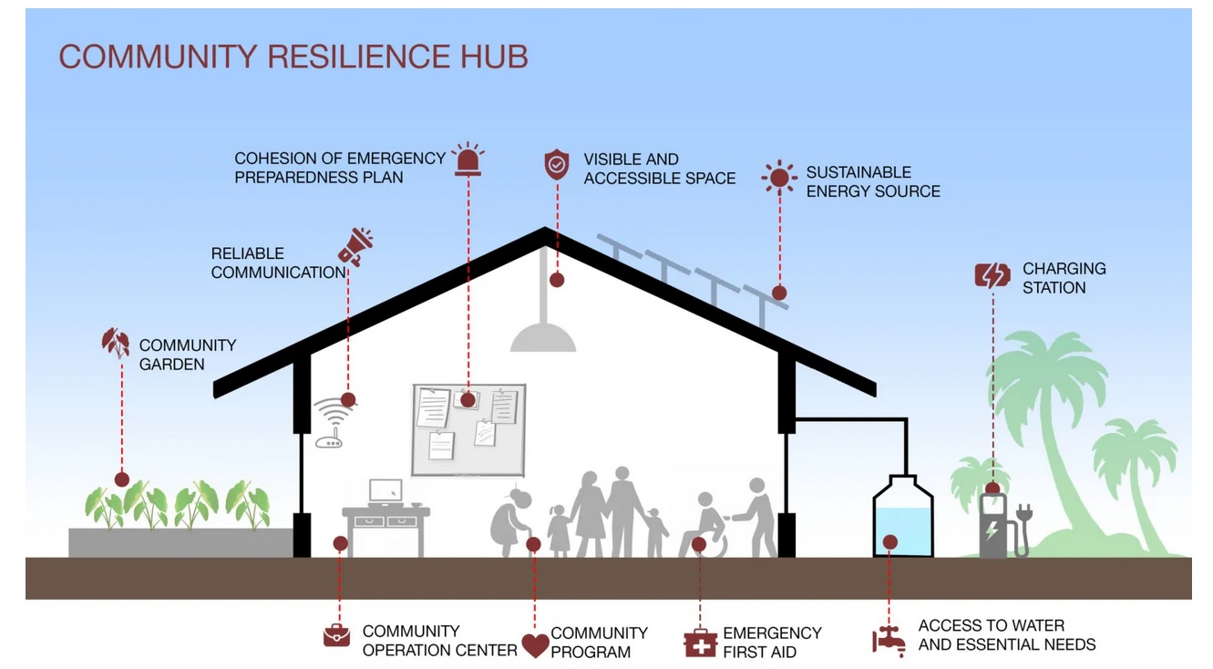
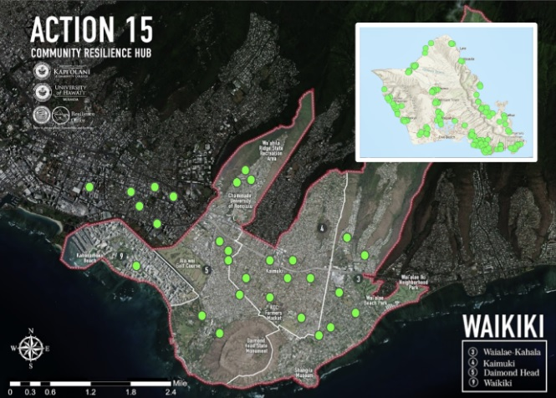
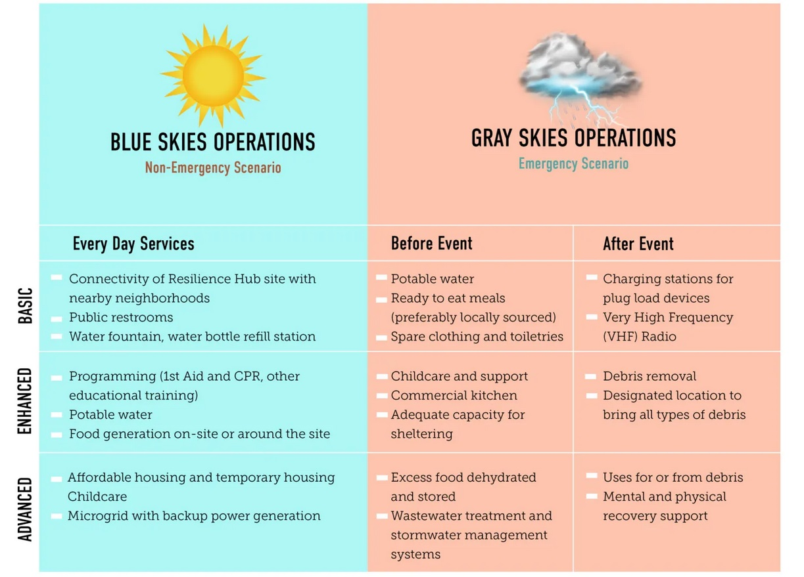
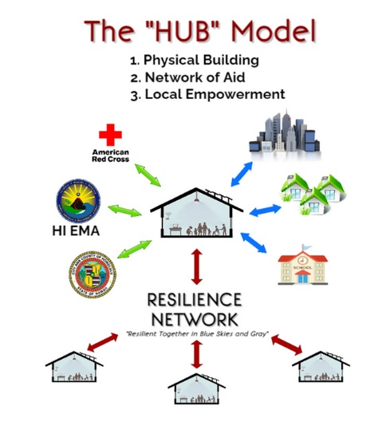
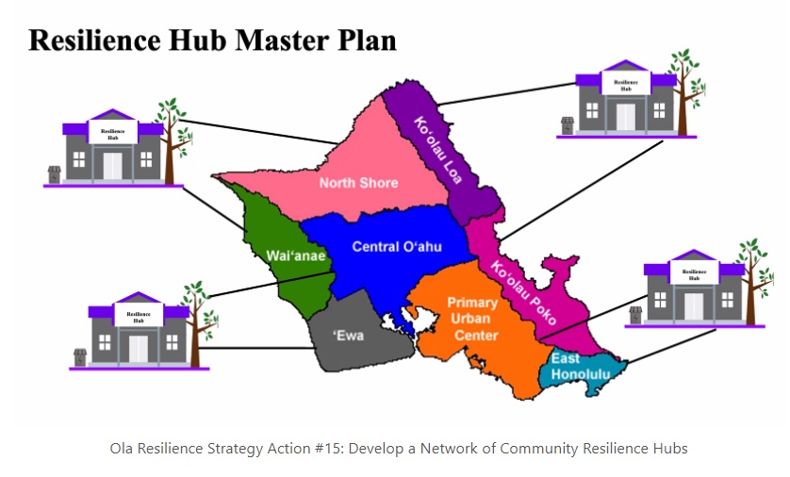
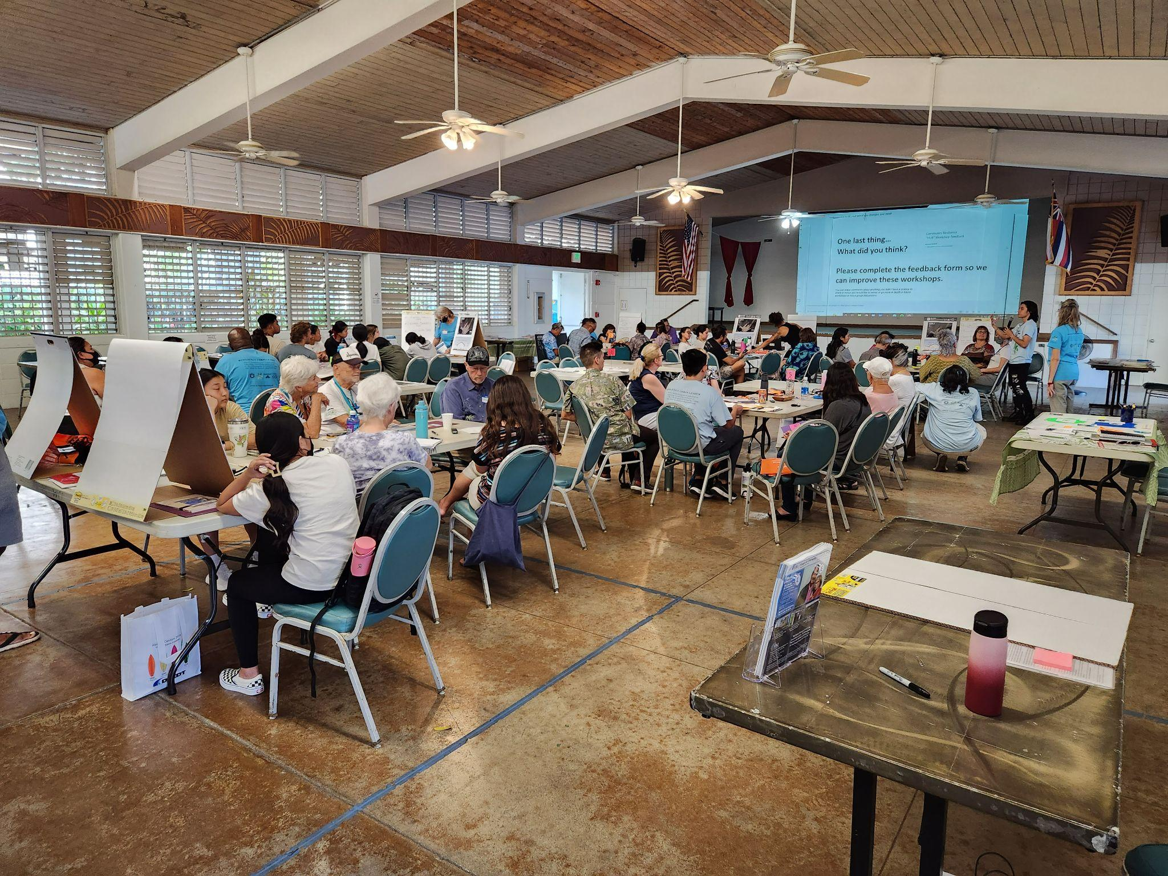
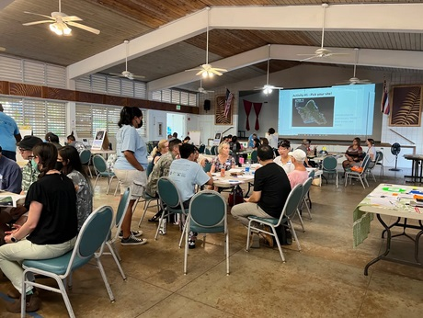
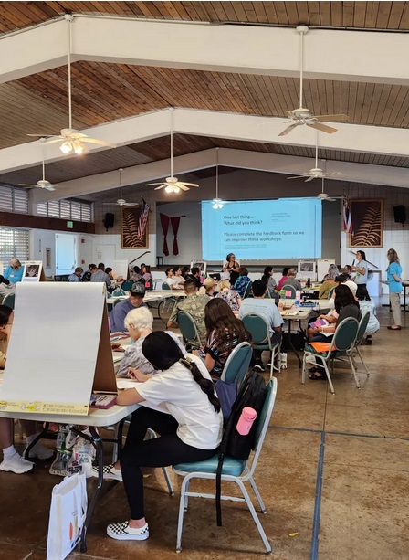
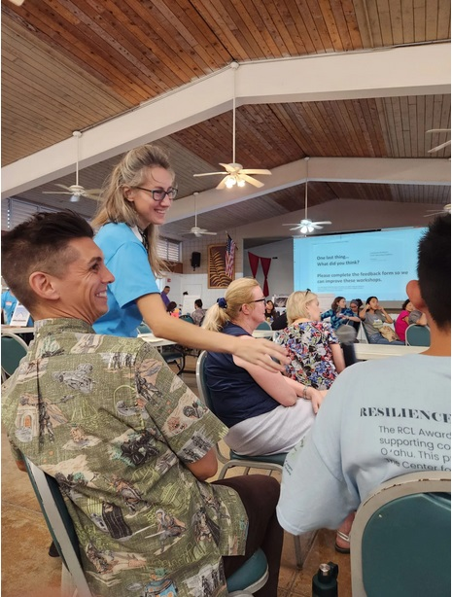
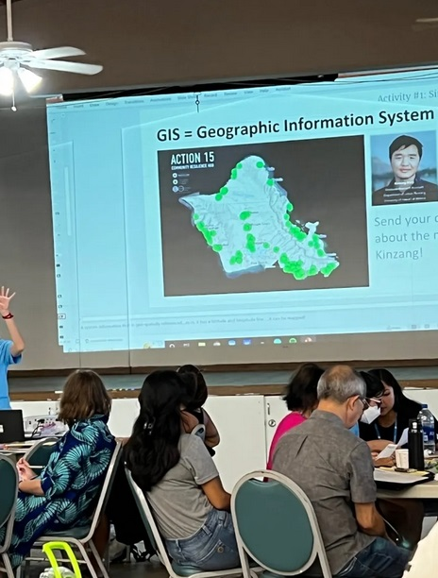
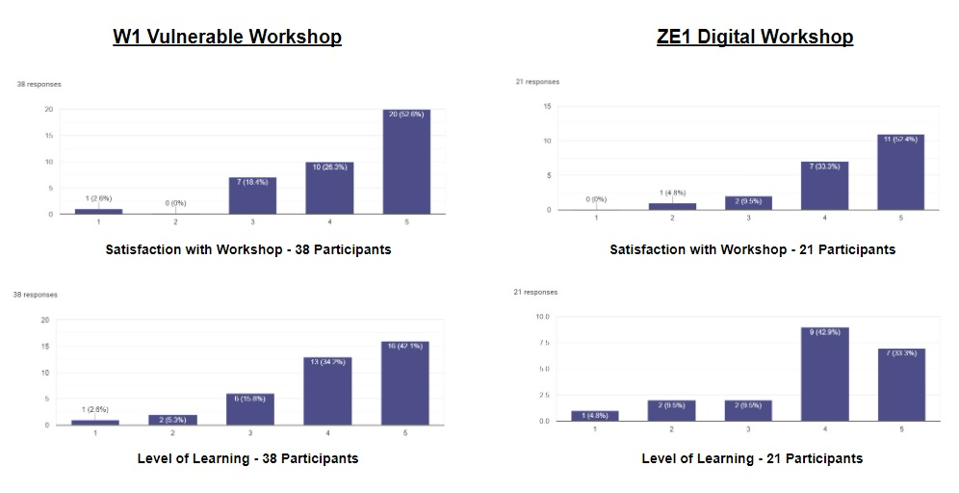
Resilience Across Oʻahu: Examining the Action 15 Community Engagement Process
‘Iwalani Clayton
CERENE Resilience Corps Leaders Award Program/Undergraduate Research Assistant
Kapiʻolani Community College
Introduction
Data Sources
“Action 15” Community Resilience Research is a continuation of the Ola Resilience Strategy for Oʻahu created in 2019: https://resilientoahu.org/resilience-strategy. The Ola resilience plan calls for 44 actions to help create a more resilient Oʻahu based on the 4 Pillars of Resilience. In our Action 15 Research, we are most focused on “Bouncing Forward” as we face natural disasters.
The mission of CERENE is to create a community-based applied research center supporting the development of a resilience network for the improvement community dedicated to a more resilient Oʻahu.
The Kapi’olani Community College Center for Resilience Neighborhoods (CERENE) works in collaboration with the City and County of Honolulu, the Office of Climate Change, Sustainability, and Resilience, and the Department of Urban and Regional Planning at the University of Hawai’i at Mānoa.
Audio recording of focus group table discussions
Transcripts from the community engagement workshop audio files
Participant feedback evaluations and post-surveys
Participant observations and opinions
Field Notes, Memos, and Reflections
Pre-existing literature or resources
Photographs taken at the workshop and of the research gathered
HECO Workshop Recordings: https://www.hawaiianelectric.com/clean-energy-hawaii/community-meetings
CERENE website: https://cerenehawaii.org
Workshop Process Goals:
· An equitable and inclusive process
· Empowerment for community resilience and disaster preparedness.
· Provide education and support for learning about community resilience.
· Empower students and support them in cultivating leadership and social science skills.
· Generation of social capital and “sense of community.”
Workshop Outcome Goals:
· Identification of the top recommended sites
· Evaluation of site suitability
· Evaluation of critical services offered at sites
· Recommendations for next steps and priorities.
*Map from WCC Community Resilience Hub Workshop
Research Question
Addressing the question: Did the Action 15 Resilience Hub Workshops meet their Community Engagement Goals?
Data Limitations
We are tasked with assisting our community in becoming more resilient during Hawaii's most damaging natural disasters. These types of threats include floods, fires, lava flows, landslides, earthquakes, coastal erosion, elevated winds, high waves, tsunamis, hurricanes, and sea-level rise.
Not all workshop participants provide evaluation feedback.
Not all participants will give their input or opinions during the workshop. They may not complete feedback requests or surveys because they refrained from actively participating in the workshops and felt intimidated by more assertive and dominating table members.
Data does not adequately indicate competence or changes in knowledge, changes in personal attributes, or what future impact the knowledge they have gained from the workshop will make.
Proposed Methodology
The goal of this research is to identify eight to sixteen possible sites for community resilience hubs in each of the major planning areas of Oʻahu. The Action 15 research is being conducted by researchers at CERENE in collaboration with the Department of Urban and Regional Planning at the University of Hawaiʻi at Mānoa in partnership with the City and County Office of Climate Change, Sustainability, and Resilience to build on the work of the Ola Resilience Strategy.
The following photos capture a few moments from the Waikīkī Community Center (WCC) Resilience Hub Workshop.
Data Summary
The methodology draws from community-based research, programmatic analysis, and indigenous research methods. We also used geospatial analysis, utilizing the ArcGIS online story map interactive tool.
Data from feedback forms for workshop W1 Vulnerable and ZE1 Digital.
Acknowledgements
Mahalo, Dr. Miku Lenentine, who guided us in this research, and State Farm and Hawaiian Electric, who sponsored this project.
Notes:
Overall, looking good! Still some work to do.
Please add in the expected data sources, data limitation and future recommendations.
Completed boxes and used font Playfair display for the paragraphs and Libre Baskerville for the titles. Sizes of font vary for fit. Alignment adjusted.
Changes made 11/29/2022-11/30/2022. Presentation Transcript completed and submitted on 11/30/2022.
Please add in the “problem” you are addressing with this proposed research and analysis somewhere in the introduction. Or the goal you are seeking to address with this research. (Let me know if you need help with this!)
I’d like to see more in your Methodology section. Because this is a research proposal usually more time is spent on the methods. Also..are you really using all those methods for your particular slice of the research pie? (hint: you aren’t really…not the GIS at least…but maybe? How will looking at the GIS data give you an understanding on whether or not the workshops have met the goals for the research process?).
How will you measure if it is an equitable and inclusive process?
How will you measure if people have received education?
How about empowerment?
(Note: some of this will be answered by what your expected data sources are).
Ask Chris or me if you need help.
Here are some examples of data you might use
Audio recording of focus group discussions
Transcripts from community engagement workshops
Participant Feedback evaluations
Participant observation
Field-notes and Memos
Pre-existing literature
Photographs
HECO Workshop Recordings
LOCATION
Accuracy / Capacity
HECO Workshop Recordings
Was only able to conduct a cursory analysis. Further more in-depth research and design would be required to draw more complete conclusions.
Here are examples of data limitations…
We might not get feedback evaluations from every participant
We had a number of walk-ins, who may not have received an “overview of the project in advance”
Because the research is conducted by students there may be additional errors in the initial workshops as students were still learning the protocols
This work is a reflection of a case study of O’ahu

