Slide 1
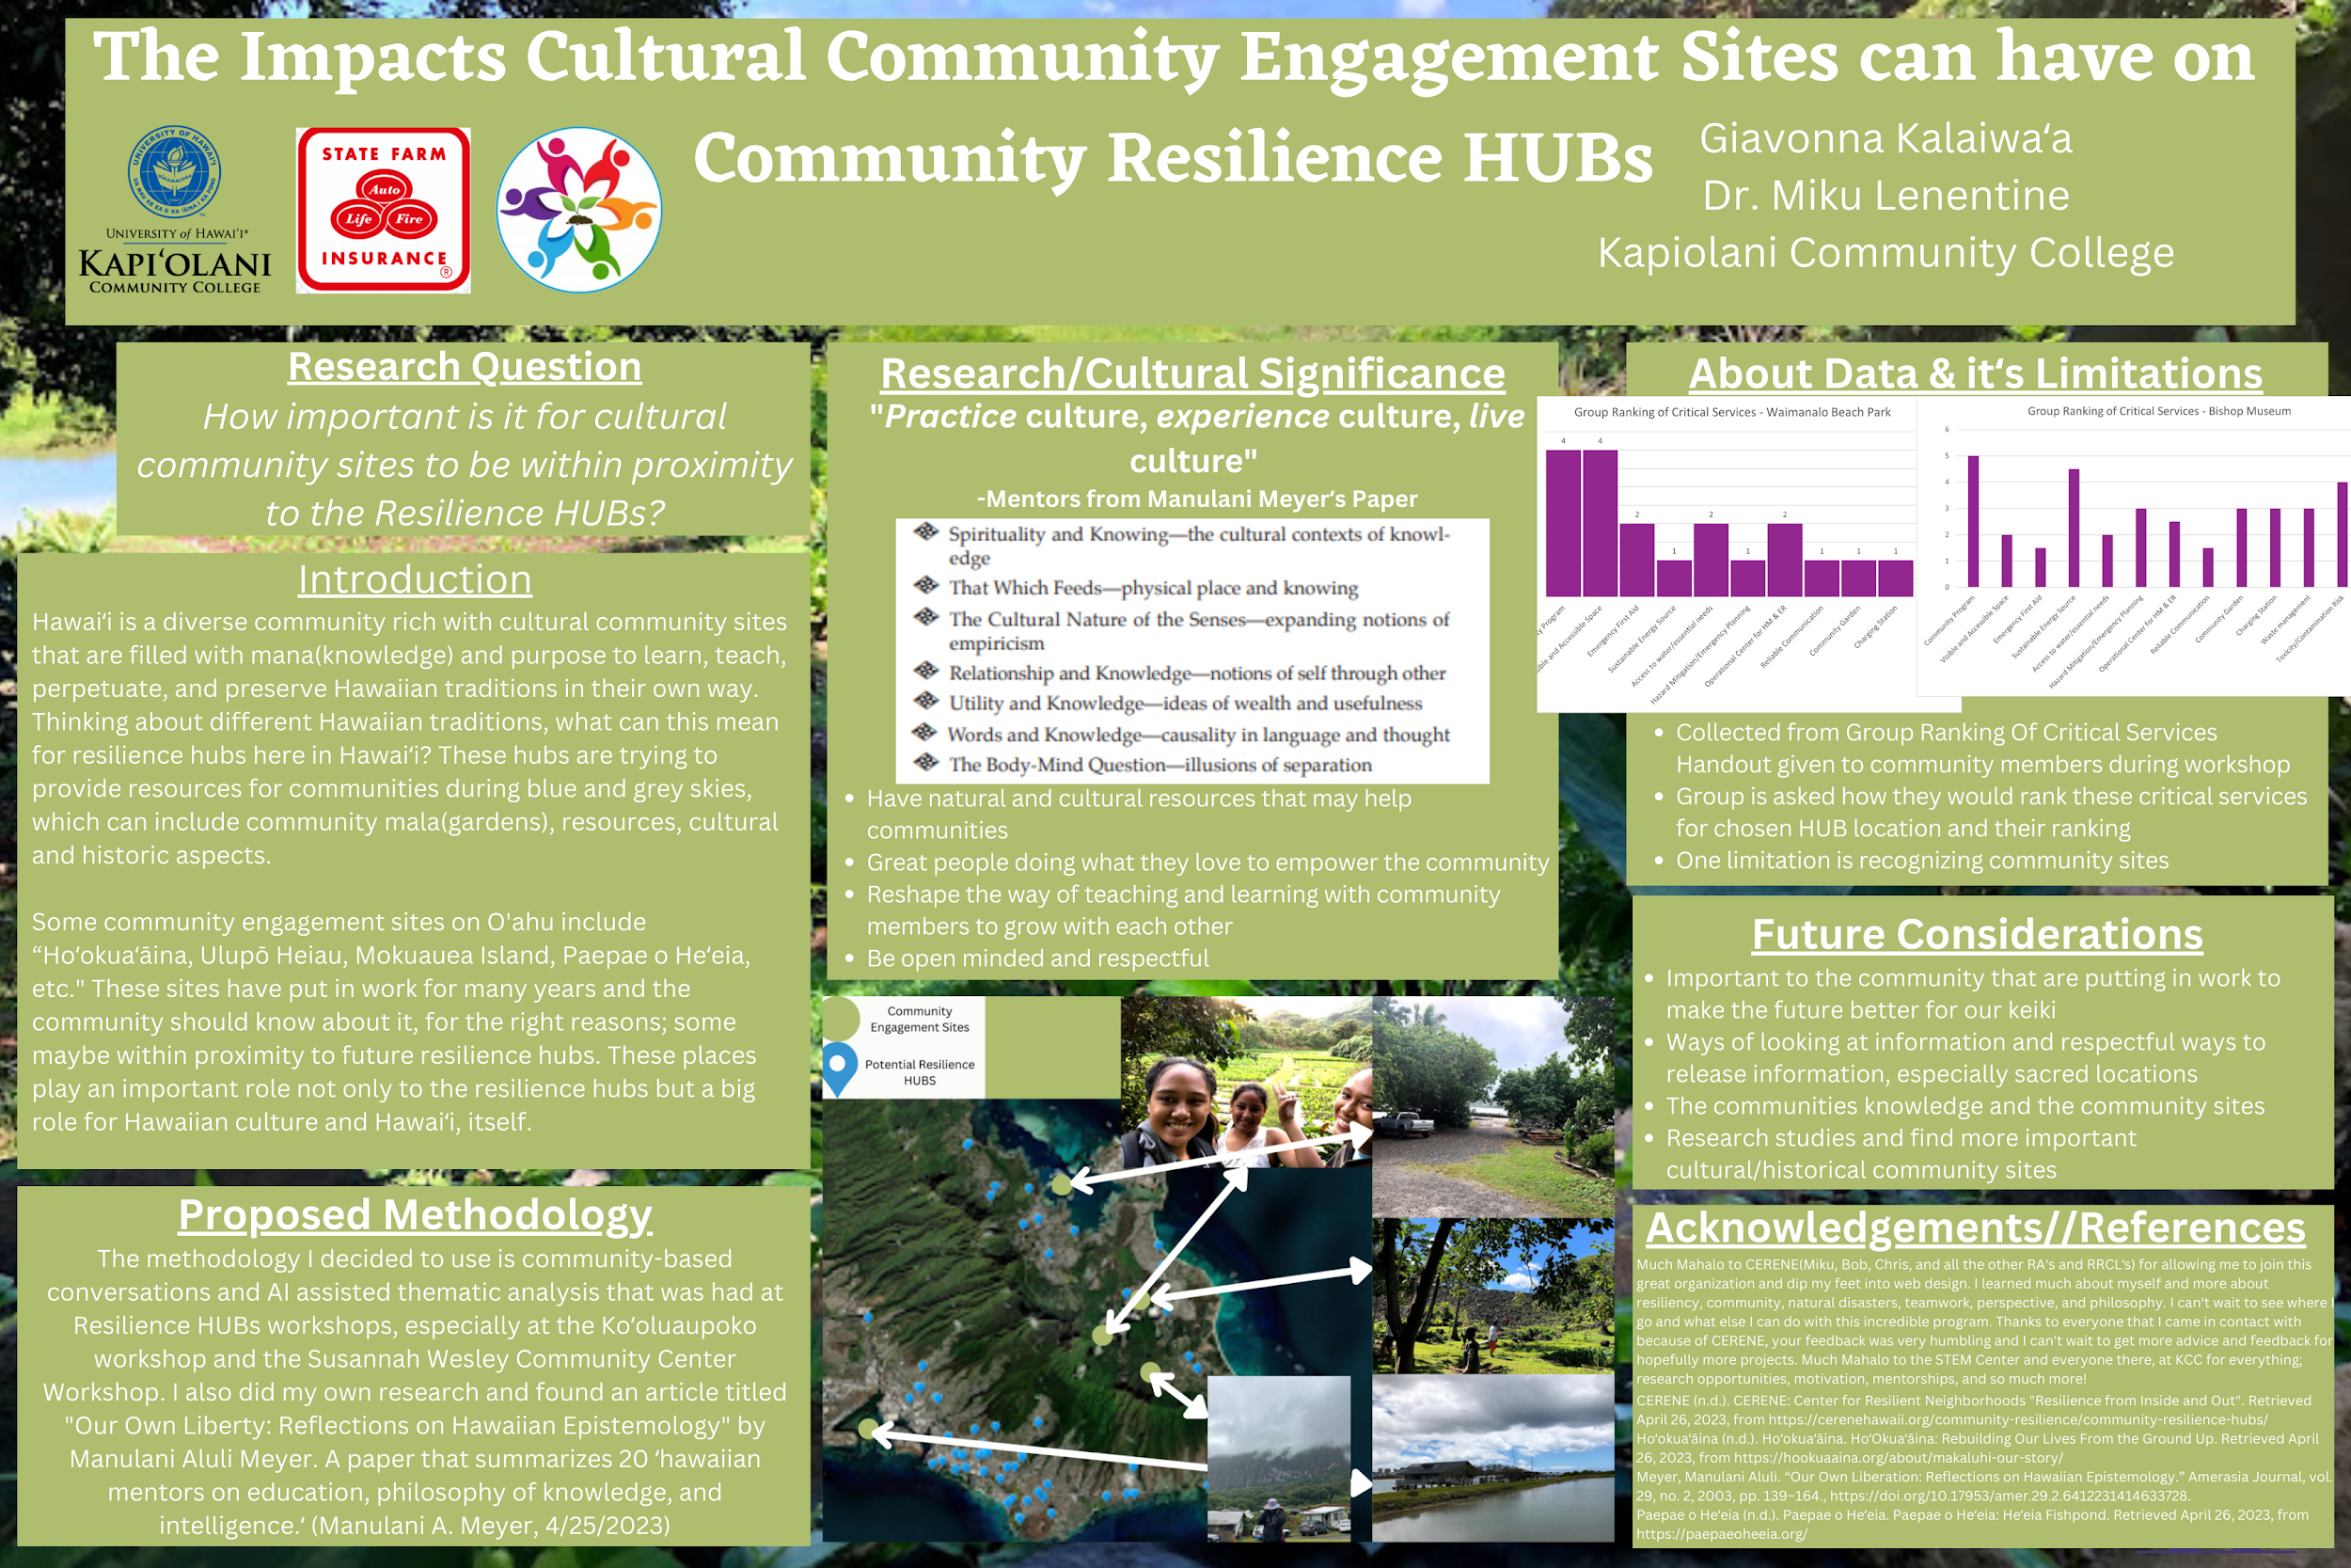
Notes:
Okay..feedback…I LOVE the maps and photos :)
Very cool design. Excellent work on your preliminary findings.
Some suggestions…..photos should have a white “wrapper around them to distinguish them from the background.
The two graphs should be smaller so they dont overlap.
I think since all the other text is left justified we just left justify the methodology section
I think a little darker green for the text box color will help the readability of the white text. So…just a few shades darker green.
For the About the Data section… you can rename it to “Preliminary Results” because it actually is about finding. Nice work! Excellent.
I would separate the acknowledgements and references section..or put in a QR code that opens up as a google doc for the references.

