Slide 1




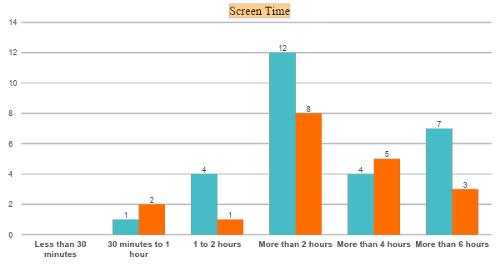
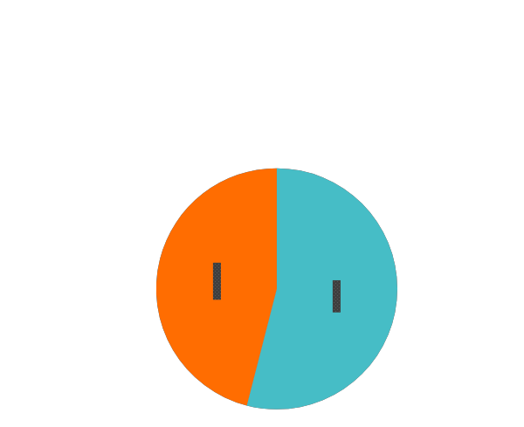





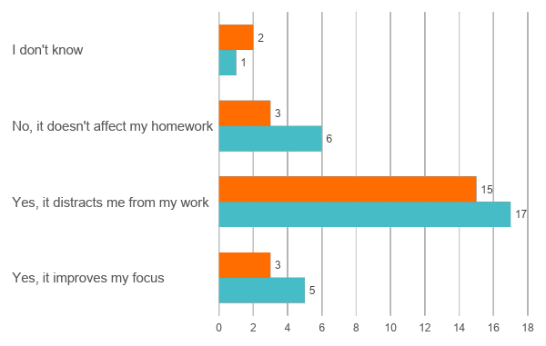

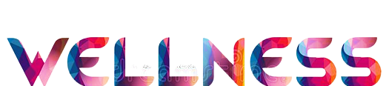



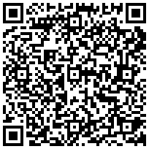

The Impact of Social Media on Personal Growth: Exploring the Relationship between Elementary and College Students (Pilot study)
Kapiʻolani Community College
Introduction
Results
Social media has become an integral part of our lives, but excessive use has raised concerns about its negative impact on wellness and personal growth.
A Pew on 2021 study found that 84% of young adults actively use social media, highlighting the need to understand its relationship with mental health and self-esteem.
To this purpose, this study designed to have focused on understanding the impact of social media on well-being. By exploring the relationship between social media use and various aspects of personal growth to shed light on how we can use social media in positive, and productive ways.
Parameters evaluated
Concentration
Study quality
Homework distraction
1
2
3
4
5
6
7
8
9
10
Emotional wellness
1
2
3
4
5
6
7
8
9
10
Method
Conclusion
As part of a pilot study, the current research aimed to evaluate a questionnaire with a sample of 50 KCC college students. Between April 18th and 25th, the study advertised the questionnaire and received 52 responses via Google Forms. Initially, outlier samples were removed, and subsequent data analysis was conducted.
Pilot phase
Original Phase
To sum up, this study aimed to investigate the factors that could influence a student's personal growth, considering their gender, age, and student status. The results indicate that students' awareness of the pros and cons of social media has a crucial role in their personal development. The pilot study also highlights that a 75% of students have faced discomfort on social media platforms. Nevertheless, a 70% of the students consider social media as a source of inspiration for their creativity.
These findings can help educators and policymakers develop effective strategies to ensure a positive impact of social media on students' personal growth.
75 Elementary student
75 College student
50 college students
QC, remove outlier data
QC, remove outlier data
Pooling Data
Data Visualization
Data Visualization
salinasn@hawaii.edu, miku4@hawaii.edu, mahmanza@Hawaii.edu
Notes:
Aloha Mo, quick comments from Dr. Miku here:
excellent work!
very nice layout and design
Introduction:
this study is designed to understand the impact of social media on well-being
Method:
Should be “Methods” as the section header, or Methodology
KCC should be KapCC if abbreviated
Results:
Very nice results section. I like how the parameters evaluated is so clear!

