Slide 1
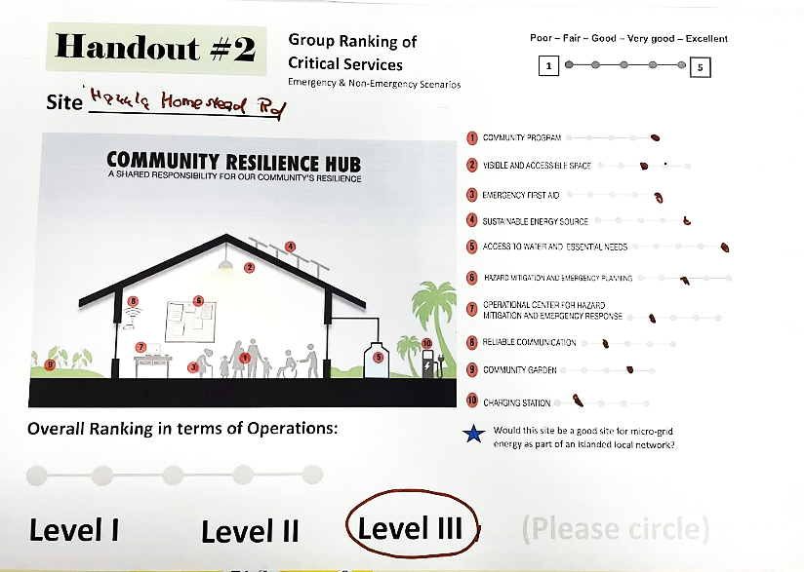
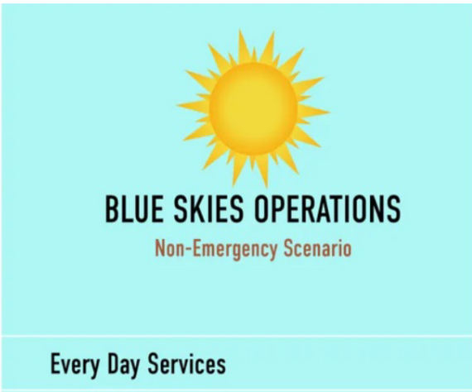
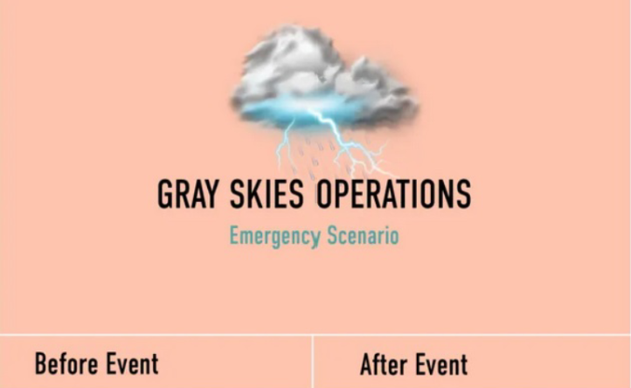
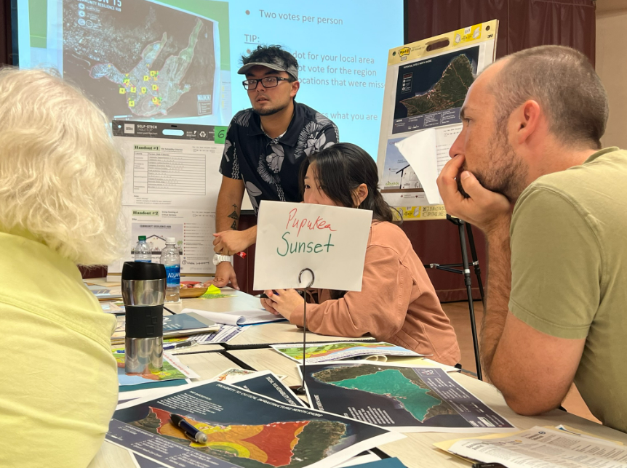
Effects of Disaster on Wastewater and Waste Management Systems Research With the
Action 15 Community Resilience Hub Project
Sean Priester, Dr. Miku Lenentine
01. Introduction
04. Data
CERENE is tasked with leading the community engagement effort for the Action 15 Resilience Hub research project. This process includes coordinating and facilitating community workshops and focus groups with the intent to collect data in support of the development of well-equipped resilience hubs with the guidance of research data collected and analyzed from these workshops.
The goal of our team research is to evaluate questions such as site suitability and the availability and quality of critical services for hubs located in each of the 8 sustainable planning areas across O’ahu. The research topic for my part of this study is focused specifically on wastewater and waste management systems.
The data analyzed in this preliminary analysis include notes, audio recordings and transcripts from 3 different focus groups from several workshops conducted in Ko’olaupoko, Ko’olauloa and the North Shore. What was immediately apparent in reviewing the discussions and notes was the enthusiasm with which the community participates at every workshop held. Community support of Resilience Hubs was consistently ranked high in previous survey research conducted in this project. That said, participants also discussed challenges to communication systems, and sustainable energy sources as common denominators for critical services during an emergency.
02. Research Question
At Community Resilience Hubs (CRH) what is the impact the community has on wastewater and waste management systems during times of disaster? Specifically, what are the priorities, needs, barriers and solutions for resilient wastewater systems on O’ahu?
05. Preliminary Results
Figure 1. Example of group ranking process considering critical needs for resilience hubs
One of the sources of data that we can glean preliminary results from is the Group Ranking activity we used with workshop participants. It provides a snapshot of quantifiable data that is both available to evaluate during the workshop and it also allows for a richer dialogue. It is out of that dialogue that new criteria that are of concern to the community emerge. In this way, we can support the community discussion and discover new needs and concerns as they arrive. This iterative process supports the creation of new criteria to be added to the discussion at subsequent workshops.
Top Themes in Focus Groups Sampled:
Theme 1: Coastal Communities
Theme 2: HUB Networks
Theme 3: Dedicated Full Time Hazard Mitigation, Emergency Planning Staff
“Being several generations in our community we have a lot of really valuable insight that can be helpful.”
“Grandma on the corner will make food for 500 if she has to“
“[The] wastewater treatment plant should it become impacted by any type of swell or any type of inner water movement is at sea level, so we’re talking not just about the physical aspects of what’s happening in water, now we are talking about contamination [and] it is in the middle of our community,”
06. Conclusion and Future Research
03. Methodology
The topic of wastewater and waste management is a relatively new inclusion in the Action 15 resilience hub workshops as a direct item for ranking and group deliberation. It is an important criterion in Community Resilience Hubs. Additional considerations for the future are the differing needs of our rural communities compared to urban centers. Also, the issue of retrofitting existing needs or developing completely new systems needs to be considered. Limitations to this preliminary analysis are that the data sets are too few to be conclusive. In future efforts, we will examine the remaining data and conduct further community workshops.
Through a community-based research approach to this study, data was compiled through several methods focusing on the perspectives of community members, neighborhood boards, civic and community organizations and agencies, leaders in city and state government participants in these studies.
Focus Groups
Interviews
Surveys
Comparison studies
Literature Review
Observation
Geographic Information Systems & Spatial Analysis
Snowball Sampling Approach
Quotes of Community Resilience
Community Feedback On Local Waste Management Barriers
“Community has had to survive on its own for eons”
“Community is strong with making food when food is needed. The comm unity totally comes together“
“Our system can only handle 300. 300 and we are at capacity”
Acknowledgements: The RCL Award Program is supported by a grant provided by the Hawaii Electric Company as well as State Farm.
Notes:
Aloha Sean, main thing I am seeing here is formatting help. Please schedule a 1:1 with Chris ASAP to help fix this prior to printing.

Slide 2
