Slide 1
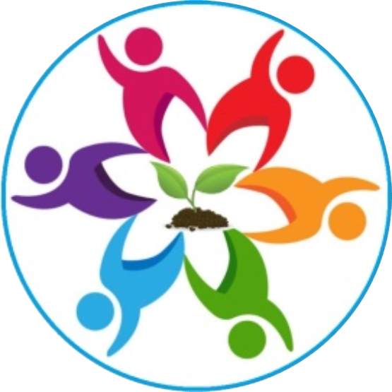
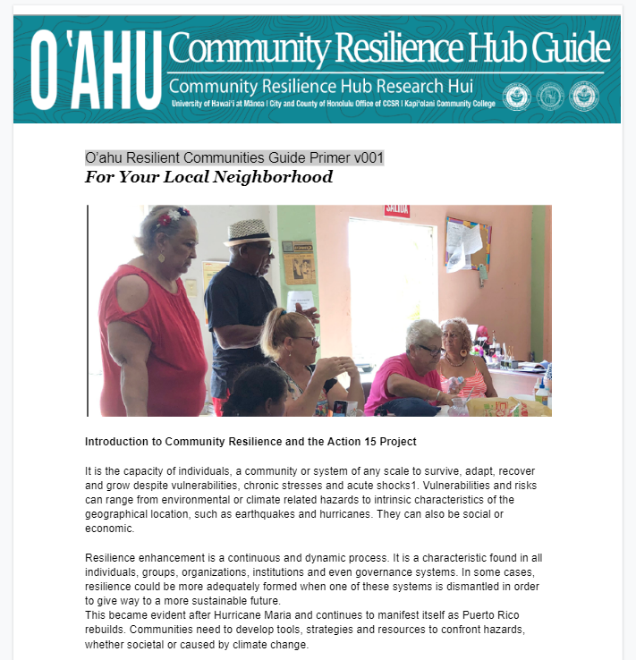
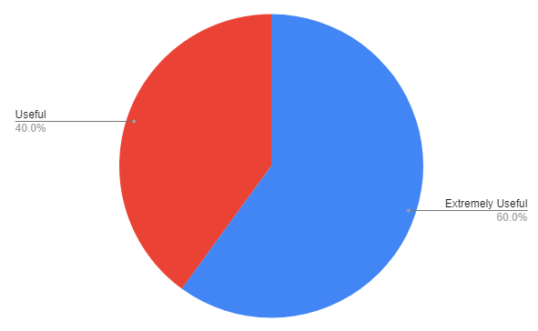
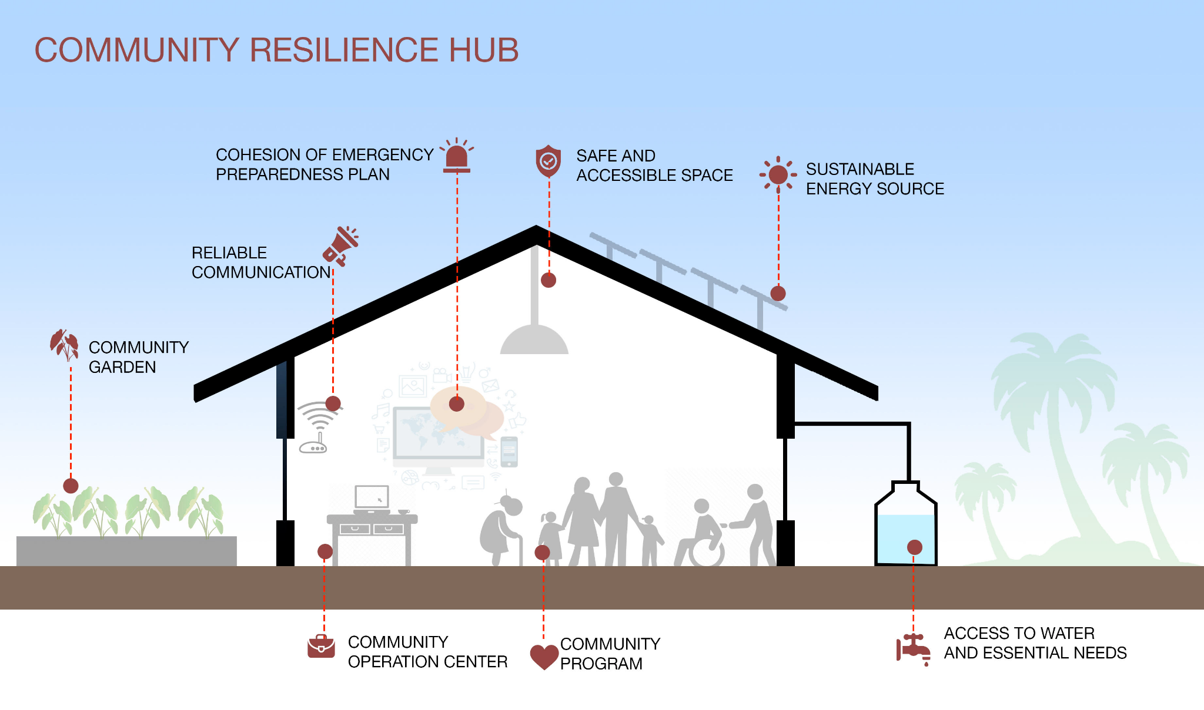
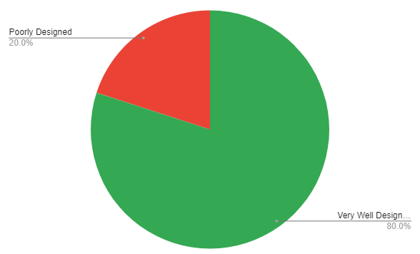
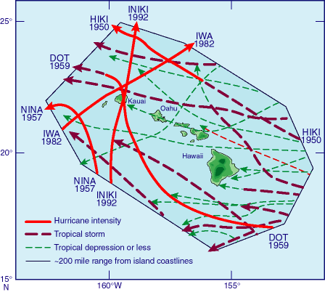
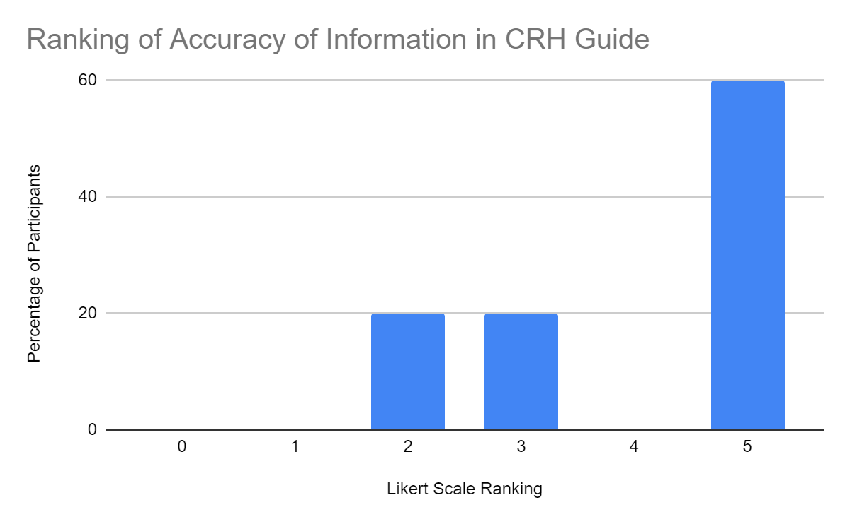
Narfe von Semkov and Sean Priester
Resilience Corps Leaders Award Program, CERENE, Kapiʻolani Community College, Dr. Miku Lenentine
Action 15 Community Pre-Engagement:
Community Resilience Hubs Guide Prototype Development
INTRODUCTION
”Resilience is the capacity of individuals, communities, businesses, institutions, and governments to adapt to changing conditions and to prepare for, absorb impacts, and recover from disruptions to everyday life, such as hazard events.” – Ola Resilience Strategy
Community Resilience Hubs (CRHs) are community-led initiatives and often are on existing organizations that provide support to their local community. Often run by an existing non-profit, often operate in collaboration with local government and serve the immediate and surrounding neighborhoods.
Data
Summary of Findings
Feedback was prompted and the guide received some thoughtful critiques and practical suggestions. Our preliminary findings suggest…
A very positive response to the guide. Of the participants surveyed 60% found the guide was extremely useful and 80% that it is very well designed.
Modifications in tone and language could improve readability and make the guide more user-friendly
A specific suggestion was that within the text of the guide that the term “non-emergency” for “Blue Skies” scenarios when referring to our “Blue Skies and Grey Skies” Model
Encouraging. As quoted the goal of the guide is generating interest of people who want to engage in conversations for their neighborhoods
Action 15” Community Resilience Research to help create a more resilient O’ahu based on 4 Pillars of Resilience. In research being conducted by CERENE we are most focused on “Bouncing Foward” as we face natural disasters.
Chart 1.. This pie chart shows responses to RCH Guides user-friendliness
Research Questions
1) What are the unique needs of the community for identifying, designing and developing a community resilience hub in the local neighborhood of the target community?
For the general public
For Vulnerable Community Members
For Native Hawaiian and Pacific Islander Communities
2) How effective is our Community Resilience Hub Guide in capturing the unique needs and priorities of the community?
3) How can we have an effective relationship within the community and the local government?,
LINK TO IMAGE
Next Steps
It is important we craft an effective guide that is the most useful for community members that accurately portrays the needs and priorities of communities in developing community resilience hubs.
Considerations of literacy, non-english, speaking, native hawaiians and pacific islander ,Kupuna and vulnerable communities are provided a guide that’s both comprehensive and specific, accessible,accommodates these diverse communities, sensitive to its diverse needs and abilities.
Our community-based research methodology encourages collaborative relationships we can then invite, a “warm ask” to focus groups and workshops. This helps to create positive relationships, build trust and enhance communication with community members the guide like this , for this purpose demands that community voices are included. As reciprocity and giving back to the community, we will give back a guide they can use in their communities, designed just for them.
Our initial research sample size though small is hardly a commentary on limitation. It is a commentary that the very important work has begun, we have made a start and have a clear idea what success looks like and the methodology and qualified researchers and collaborators. Next steps are sending the guide to Action 15 Team, conducting surveys, collecting data and working with Subject Matter experts, the City and County of Honolulu, CERENE partners, and then finally to community members.
Gray Skies Operations vs. Blues Skies Operations
Resilient Community Center: During "Blue Skies" non-emergency scenarios offer a suite of essential services to the community focusing on programmatic ideas to support the community year-round, as a gathering place, a centralized location for coordinating and distributing essential goods and critical services. During “Grey Skies” provide comprehensive emergency service community wide and specific needs based on Community-based research.
Chart 2. This pie chart shows responses to RCH guide design
Preliminary Results
Overall, I think this could be a really useful guide for communities and CERENE is doing this-its important work!!
LINK TO IMAGE
HISTORY OF HURRICANES
On September 11, 1992, Hurricane Iniki struck Kauai, causing over $3 billion in damage
and six deaths. It was the second and final named hurricane to make landfall in Hawaii since Hurricane Dot in 1959.
Lane was a low impact storm despite the incredibly high totals of rain. There was no massive property damage reported from the island from this event, most of the flooding limited to roadways and a low number of properties. Much of the inundated areas were along the oceanfront and low land areas.
Methods
Research Methodology:
- Survey Research (pretesting survey)
- Collecting qualitative and quantitative likert scale preference data, and open-ended questions regarding the effectiveness of CRH Graphic Design
- Mixed Methods Research (this means using quantitative and qualitative methods)
- Community-based Research
- Using convenience sampling to pre-test survey (RCLs, CERENE Partners, target audience, chance encounters, personal referrals)
I’m just curious how i can participate or if I missed the chance and where are the hubs going to be cited. I hope it's in my neighborhood!
I think it would be great to have this guide in different language…
Acknowledgements
Thank you for our advisor Dr. Miku Lenentine who guided us in this research, State Farm and Hawaiian Electric who sponsored this project.
Chart 3. This graph suggests…

