Slide 1


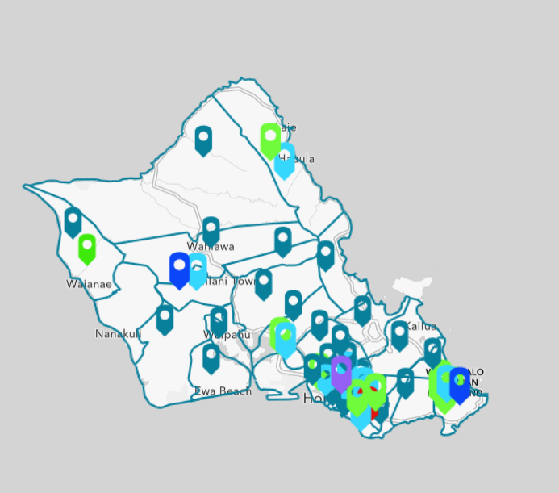
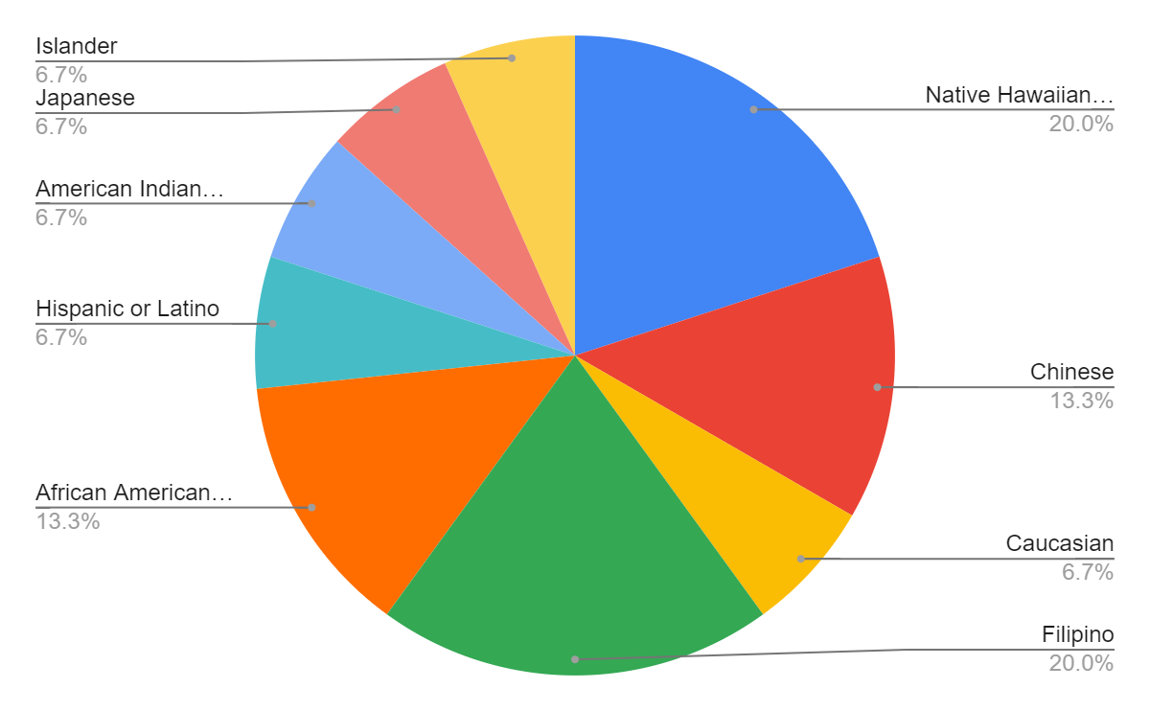
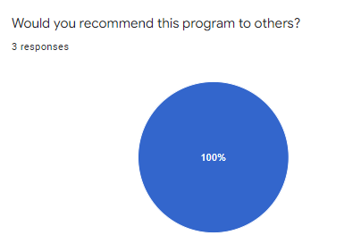
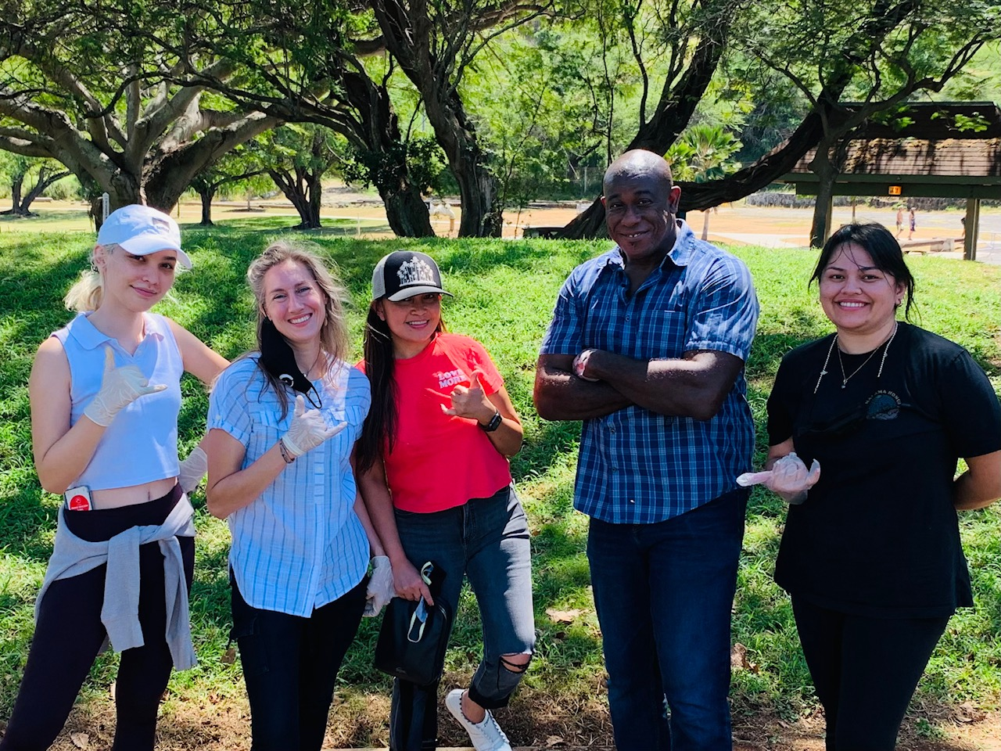
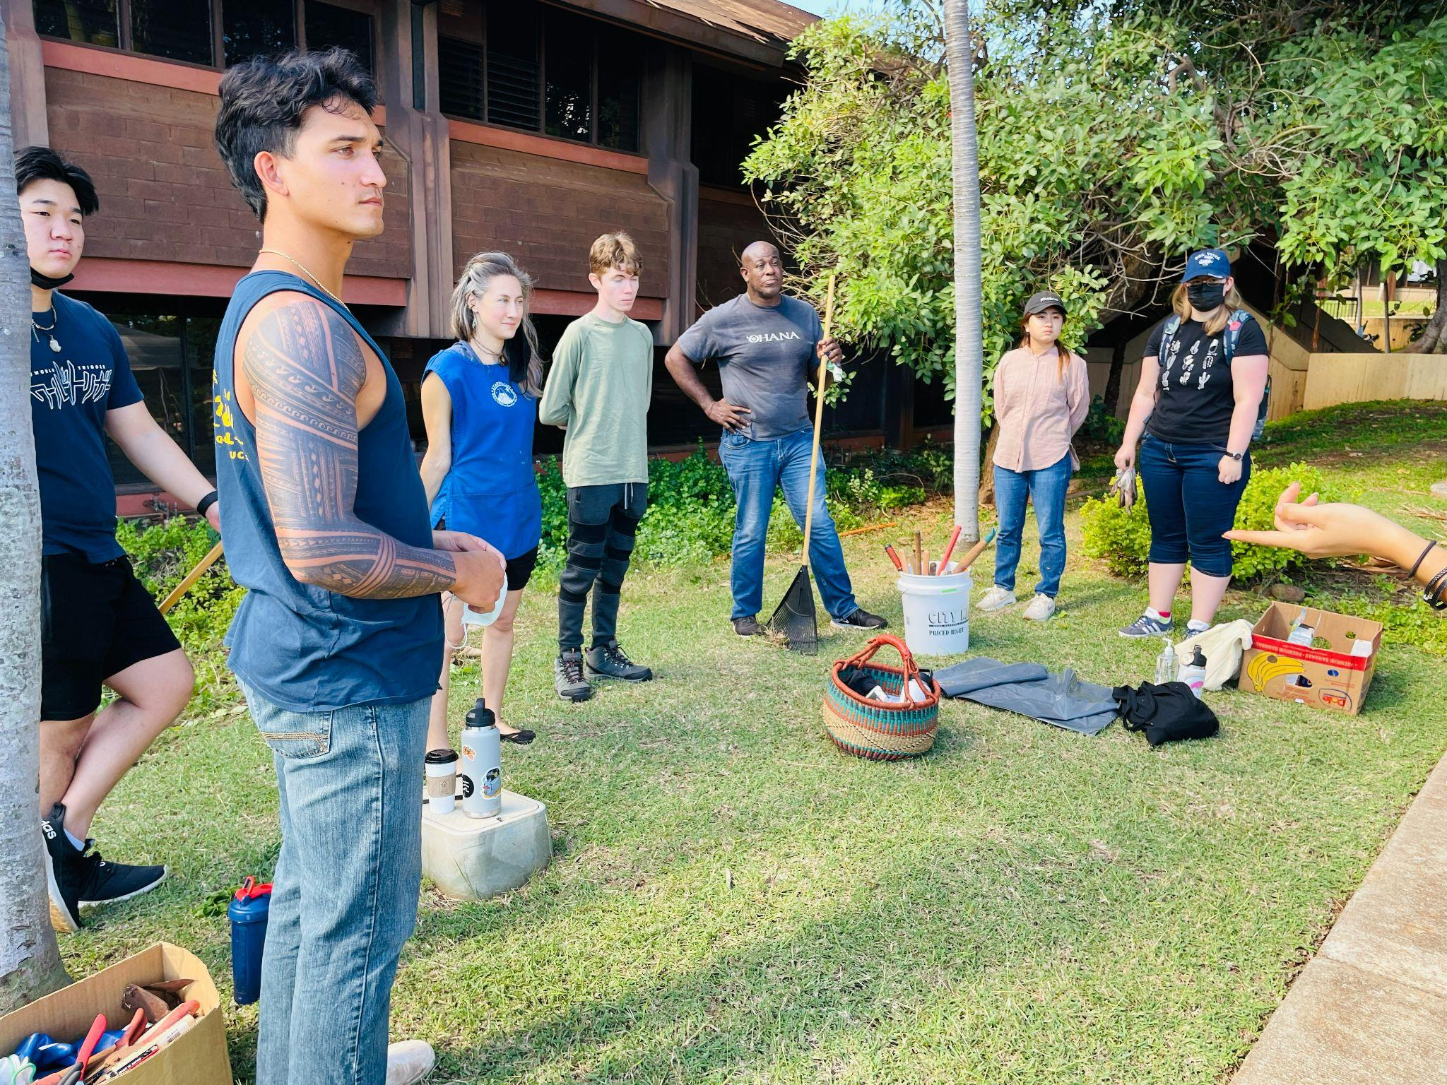
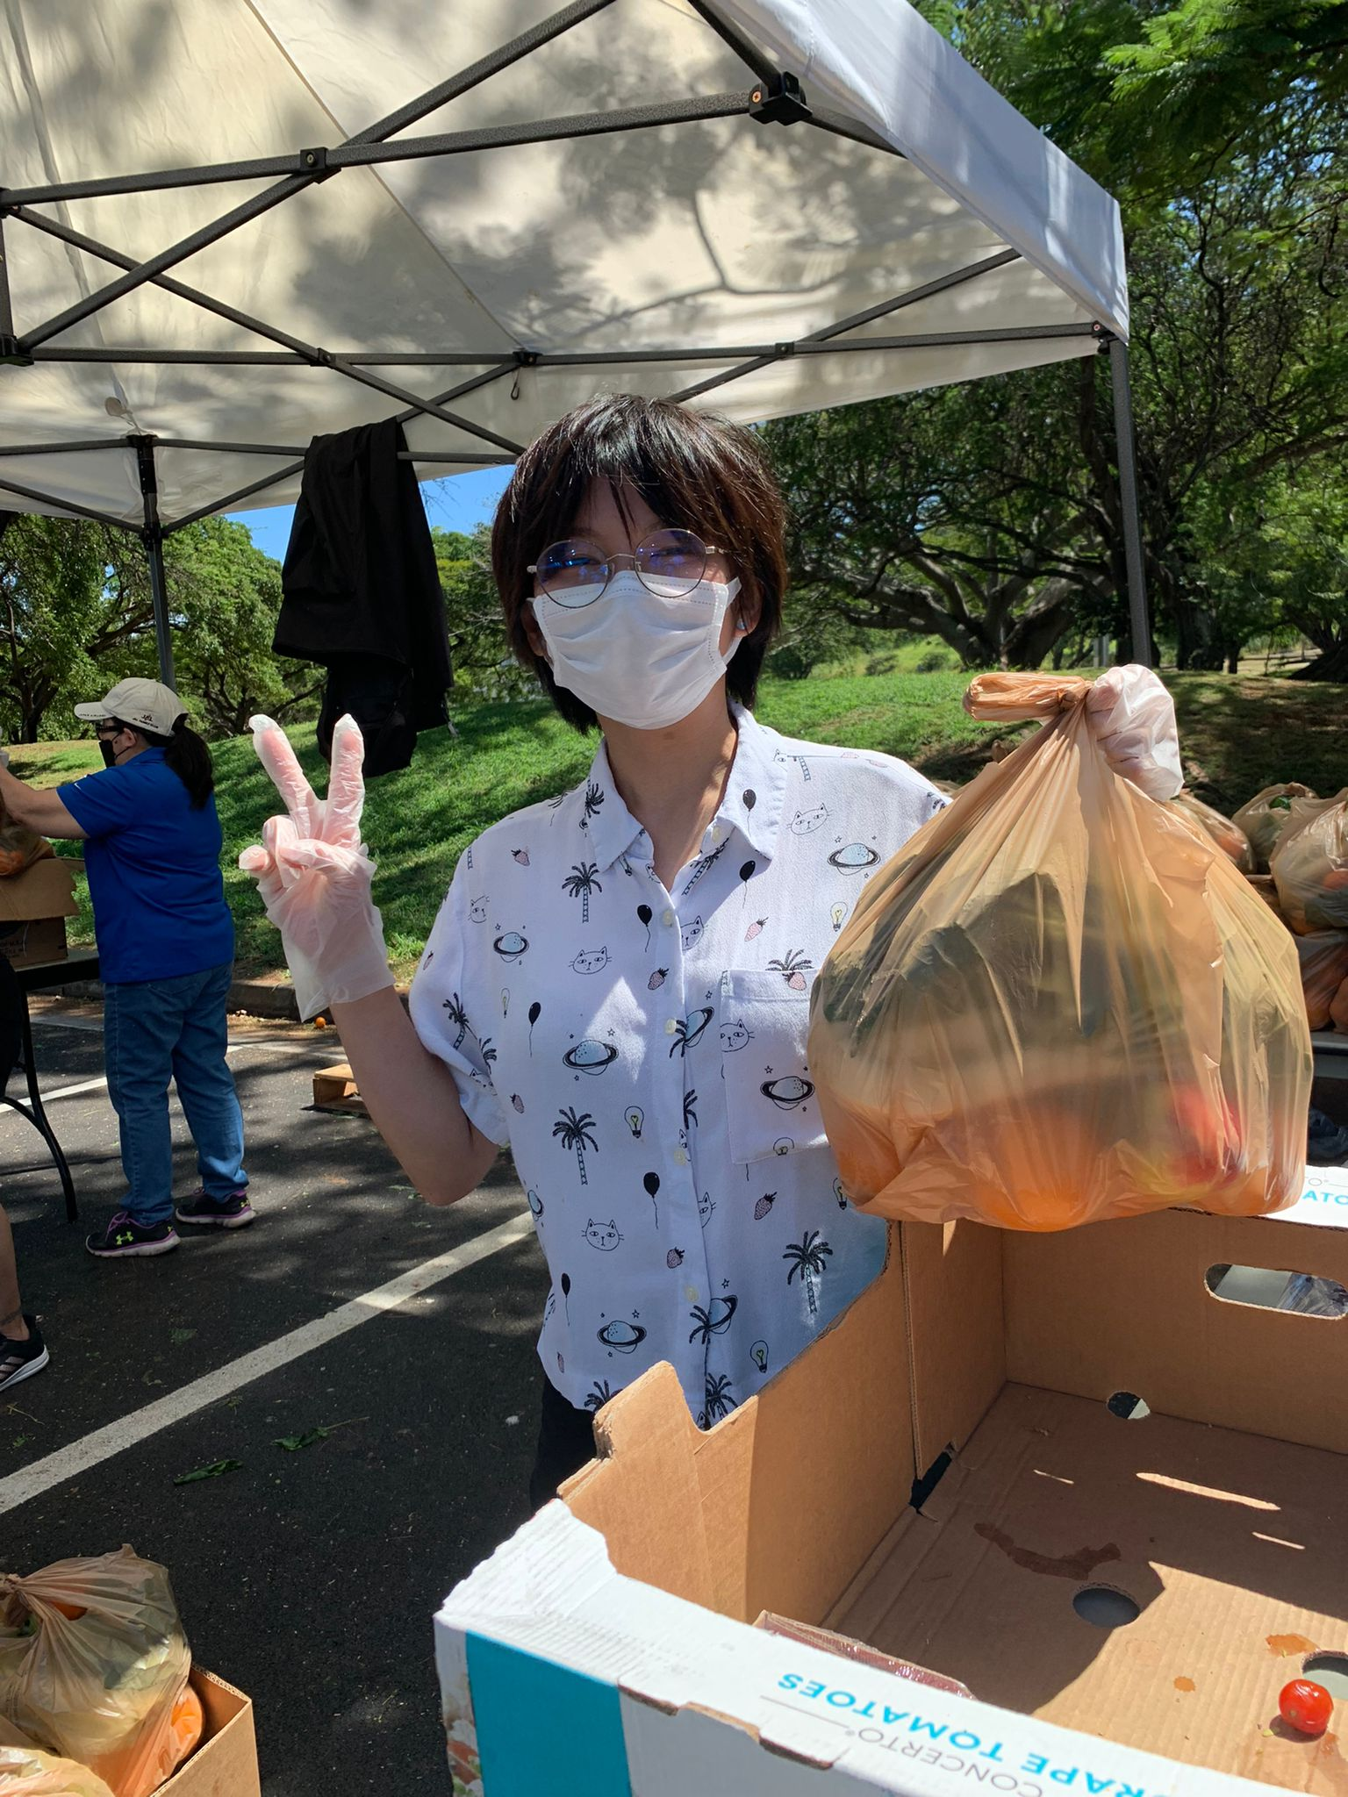
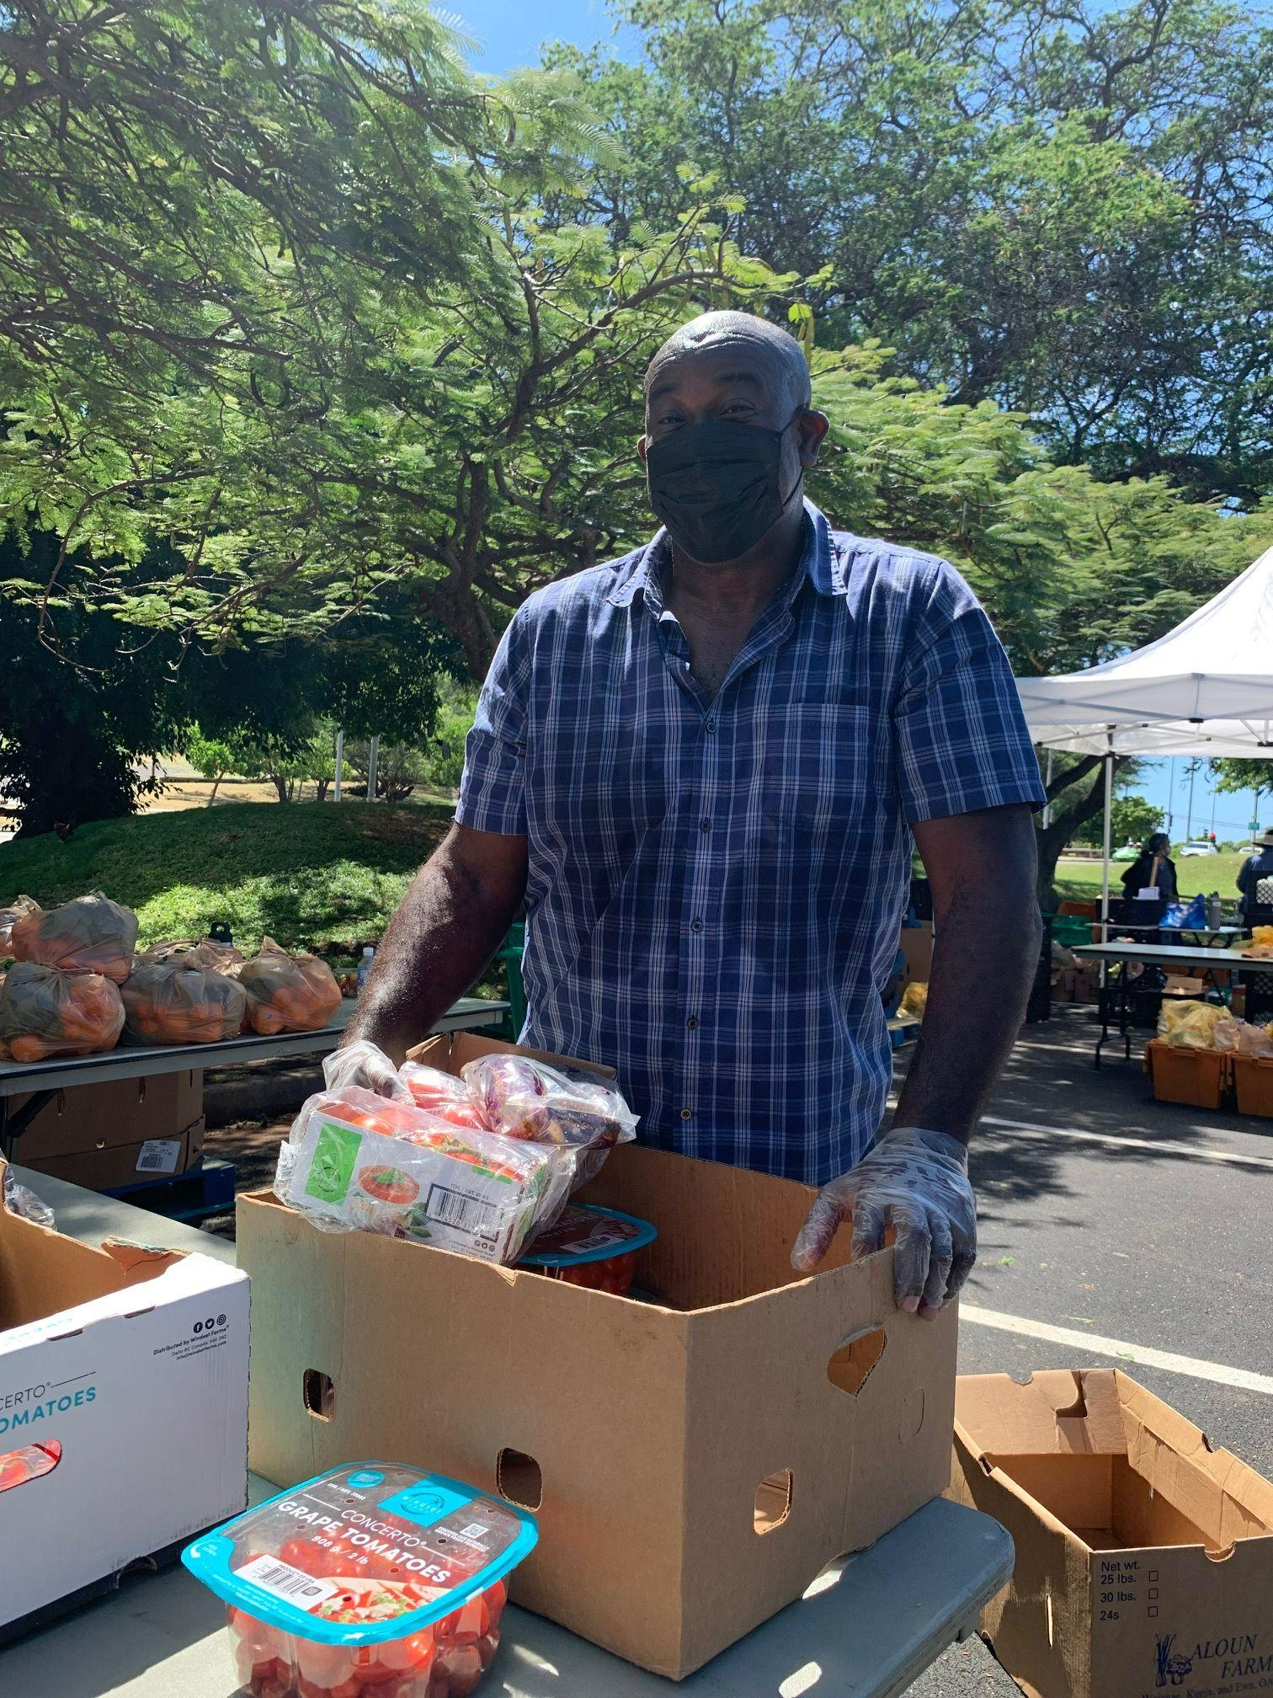
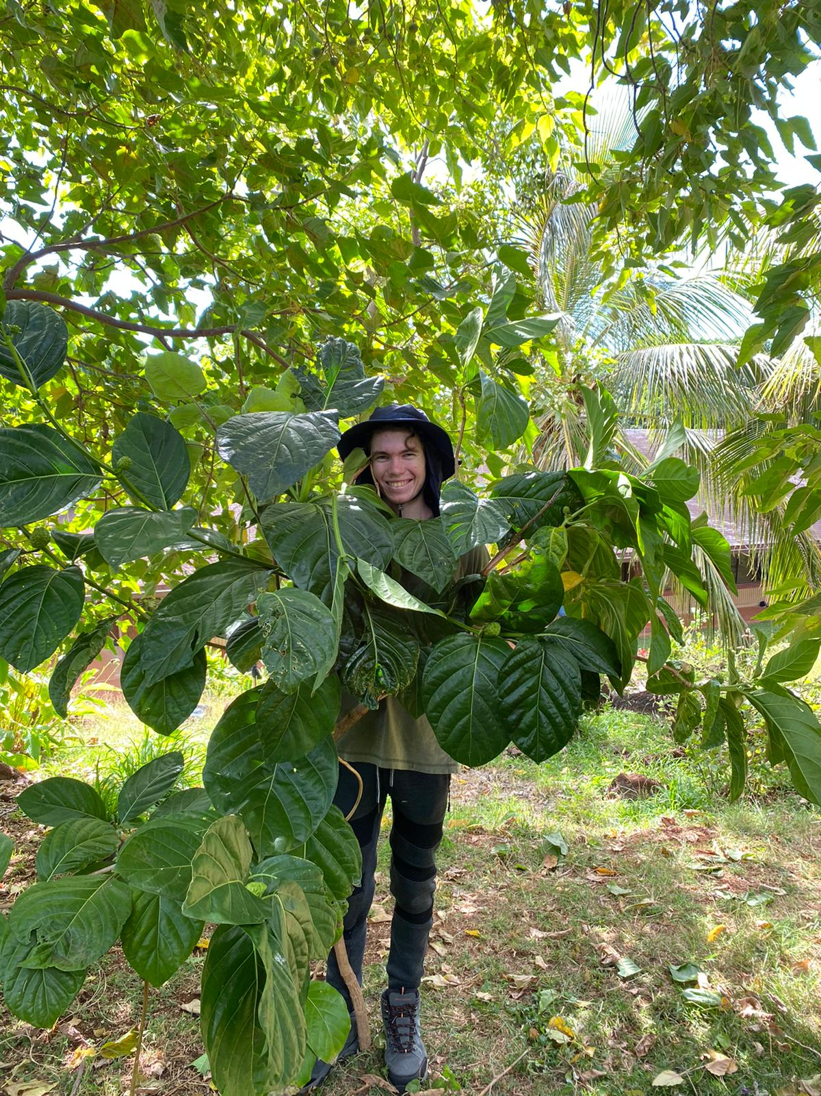
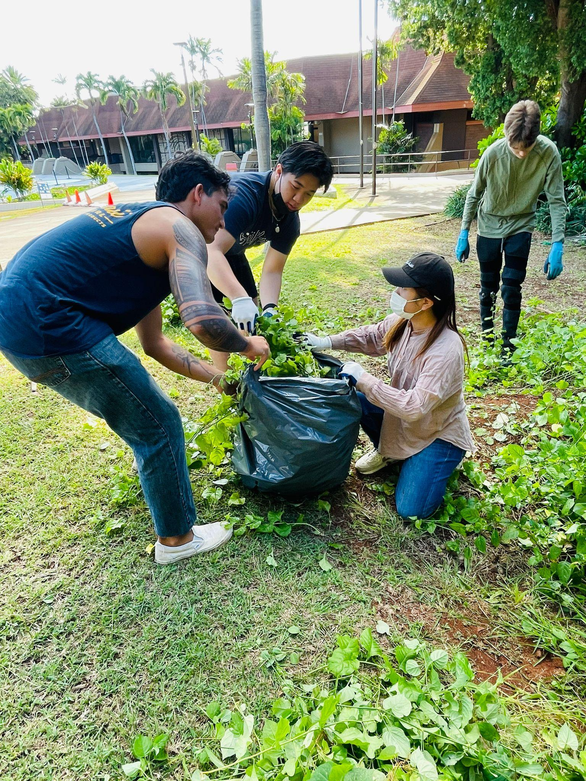


Resilience Across Oʻahu: Pre-programmatic Analysis of the Resilience Corps Leadership Award Program
Iwalani Clayton
Resilience Corps Leaders Award Program, CERENE, Kapiʻolani Community College
Background
“I learned that I can be an active community member. It's a lot more rewarding for myself to get out there and help people. There is nothing better than just being apart of something great. Now it gives me the confidence to show up and possibly create events of my own in the next phase of my life.”
The mission of CERENE is to create a community-based applied research center supporting the development of a resilience network for the improvement community dedicated to a more resilient Oʻahu.
“The biggest part in learning about resilience for me was just going out there and trying to combat different issues in the world. Seeing it first hand being able to take apart of it was a great and eyeopening experience.”
The RCLs of the Kapi’olani Community College Center for Resilience Neighborhoods (CERENE) worked in collaboration with the City and County of Honolulu, the Office of Climate Change, Sustainability, and Resilience, and the Department of Urban and Regional Planning at the University of Hawai’i at Mānoa.
"Resilience is the ability to identify what your resources are and utilize them to get you through a difficult time."
~ RCL, Cohort 1
"Adapting and fighting through whatever we may be [experiencing] and then [it is also] how [we] cope or recover."
~RCL, Cohort 2
Purpose
"Knowing how to bounce back from all the bumps, and all the the problems that arise in our everyday lives. It's not just from natural disasters..." ~RCL, Cohort 1
The purpose of this pre-programmatic evaluation is to assess if the RCL Award Program was able to meet the following goals:
Figure 1. Map of Resilience Corps Leaders “brilliance” and resilience service work across O’ahu
Learning about community resilience
Completing 30 hours for resilience service work
Creating a positive impact in the community
Stepping into a leadership capacity sharing knowledge
Completing a final project
Completing their training & certification through the National Disaster Preparedness Training Center (NDPTC) and FEMA.
Preliminary Findings
100% of students in a preliminary sample would recommend the program to others.
The majority of participants indicated they felt more confident as a leader and more confident in their understanding of community resilience upon the compilation of the program.
The RCLs collectively completed nearly 500 hours of resilience service work.
Nearly half of the RCLs participated in the KCC Student Undergraduate Research Fair (SURF).
*Study Limitations: These findings are based on limited data with a very small sample size. Qualitative data suggests we may find similar results in a complete programmatic analysis.
Figure 2. Relative percentage of ethnicities represented by the RCLS
Figure 3. Preliminary feedback from RCLs indicated that 100% of them recommend the program.
We are tasked with helping our community become more resilient during Hawaii's most damaging hazards. These types of threats include floods, fires, lava flows, landslides, earthquakes, coastal erosion, elevated winds, high waves, tsunamis, hurricanes, and sea-level rise.
Our Resilience Corps Leaders participated in a number of team events in addition to their individual resilience service work with on-campus and off-campus partners. These photos capture a few moments from the Malama Kapi’olani Event as well as the Pohukaina Food Pantry Produce Plus distribution day.
Methods
Future Recommendations
The methodology draws from community-based research, programmatic analysis, and Indigenous research methods. We also used geospatial analysis, utilizing the ArcGIS online story map interactive tool.
Complete and provide a full programmatic analysis.
Future education and resources will be provided through KCC Laulima Gateway. Using the stories of our neighborhood communities to further promote self and neighborhood community resilience.
Acknowledgements
Thank you Dr. Miku Lenentine who guided us in this research, State Farm and Hawaiian Electric who sponsored this project

