Slide 1
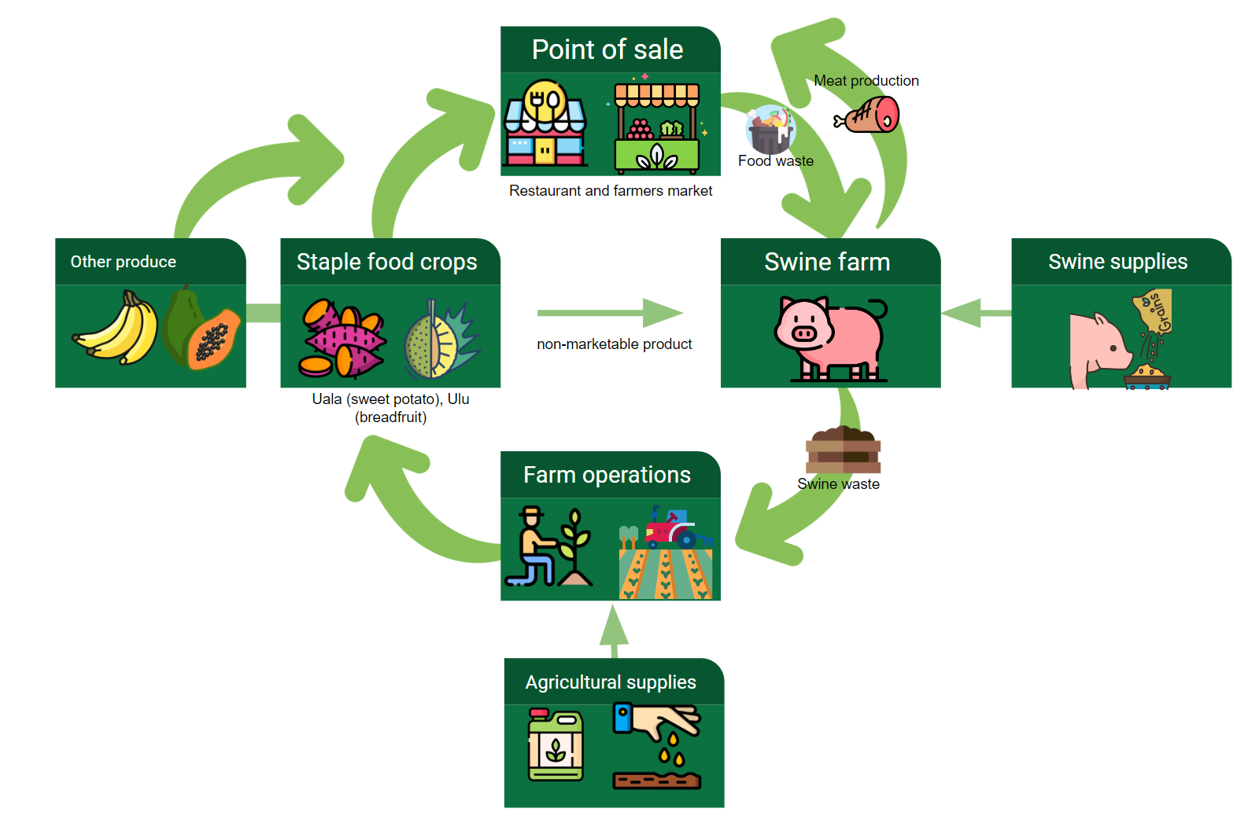
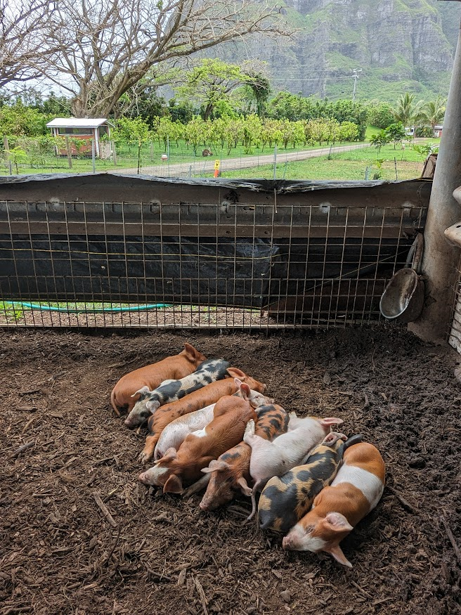
Strategies Towards the Circular Economy in Livestock Industry:
A case study of Kualoa Ranch Swine Operation
Yunuen Bustamante
Research Mentor: Jaclyn Lindo, PhD
Academic Subject Certificate in Sustainability, Kapi‘olani Community College
The implementation of circular economy (CE) models in the livestock industry has been used as a strategy to achieve sustainable livestock production. CE model proposes the limited use of natural resources in the production process and minimizes externalities.(Reckmann, K., Traulsen, I., & Krieter, J. 2013). CE business models are based on three principles: eliminate waste and pollution, circulate products or materials, and regenerate nature. Furthermore, there are five CE business models, of which two are represented in this case study: circular supplies and resource recovery. Kualoa Grown swine operation incorporates the balance between economic growth, environment, and society.
The Hawai’i Pork Market
Kualoa Grown Pork Production
The pork industry in Hawai‘i has maintained its levels of consumption for the last ten years. However, local production has declined by 3.7% despite the cost and demand. Kualoa Grown aids pork self sufficiency in Hawai‘i. The intention is to raise local pork controlling the production from farrow to finish, minimizing cost of production and transportation for traceability purposes. Last year Kualoa produced 15,000 lbs of pork. The main point sale is the farmers’ market to supply animal protein for local families. However, local restaurants and local sausages companies are demanding kualoa grown’ pork due to the added value and label of “local pork” that the local community increasingly prefers. This continue demand of local pork from kualoa causes constant shortage of pork in farmers market or restaurants.
Kualoa Ranch is a private nature reserve located on the windward coast of O’ahu. Kualoa Grown is the brand of the agricultural operations, where their farmers cultivate, and raise food for Hawai’i. Kualoa Grown piggery initiated 6 years ago based on Korean natural farming (KNF) principles, pioneering the production of local pork with a sustainable approach. The initial project was designed in a small scale with maximum capacity of 80-100 animals to determine the viability of the KNF model as a sustainable option for raising animals compared with the establishment of a Concentrated Animal Feed Operation (CAFO) which is highly profitable but unsustainable and with poor animal welfare. Kualoa Grown posses unique characteristics which provides certain advantages over emerging swine farms when it comes to the four factors of production (land, capital, labor and entrepreneurship). Kualoa Ranch owns 4000 acres of land which allows them to designate areas for farming exclusively. Also, Kualoa Ranch main revenues comes from touristic activities, some of them are diverted to subsidize Kualoa Grown capital and labor. Thus far, Kualoa Grown piggery has implemented a cost-effective, pollution-prevention, deep litter technology complaining with best management practices (BMPs), US EPA laws and the Hawaiʻi State Department of Health. However, there are areas of opportunity to achieve full circularity, sustainability and become a self-sufficient farm.
Long run strategies
Realizing expanded KNF benefits
Considering that feed costs are the main expense of the KNF piggery the following scenarios could decrease the feeding costs and became more sustainable and profitable in the long run.
Creation of employment at Kualoa Ranch to collect food waste from hotels and restaurants to feed the pigs (consider current cost of feed vs fuel and wages)
3rd party business opportunity to collect slop around Island and deliver to swine farms in Oahu (consider promoting the creation of more swine farms to make this business profitable)
For both scenarios, it is necessary the acquisition of a vehicle that can hold heavy loads of food waste and the mayor expense would be labor and fuel.
Scaling the Kualoa Grown Piggery
The high demand of local pork is making Kualoa Grown considering the idea of scaling the pork production. With resources being limited, the expansion of touristic activities would create higher profits than pork production. However Kualoa Grown vision is to aid food security in Hawai’i and supply the current demand of animal protein.
Kualoa Grown alternative for scaling the pork production combining the agroturism is the development of “pasture pigs” where in a designated piece of land (two acres) Kualoa proposes to finish their hogs in grasslands to minimize cost of infrastructure, maintenance and labor. Additionally, it will create a value added to the meat adding the label of “local pasture pork” and finally the tourists will enjoy the view of pigs raised in grasslands.
Kualoa Grown Piggery Operations
The purchase and importation of feed grain are the main variable costs of the KNF piggery, comprising almost 70% of total cost inputs.
An alternative to the importation of purchased grain would be the collection of slop from Kualoa’s restaurant and non-marketable produce from their farm to decrease the feed cost, increase total profits, and become more self-sufficient and sustainable. In an effort toward this circular economy business model (circular supplies), Kualoa Grown diverts food waste (10,000 lbs of fruit and vegetables trimmings in 2022) from the restaurant to the swine farm. Additionally, fruit and vegetables that are not market grade or are undesirable by farmers market consumers are sent to the farm to supplement the pigs’ diet. Despite the size of Kualoa’s restaurant and agricultural operations, the amount of diverted food waste still only covers 7% of the nutritional requirements of the animals, suggesting that most of the feed to raise pigs is coming from imported grain sources.
Kualoa Grown Agricultural Operations
Kualoa Grown enterprise grows 60 different crops, flowers, and five types of animal protein. The variable inputs for the agricultural production (chemical and natural fertilizer, pesticides, herbicides, seeds) are almost 90% imported from the U.S. Kualoa Grown intends to replace more of the chemical fertilizer with swine compost from their piggery to minimize the production cost, reduce negative impact to land and become more sustainable. Due to the scale of the small KNF piggery and the large scale of the agricultural sites, the amount of compost produced is not sufficient to fully substitute for chemical fertilizers. Literature suggests that a KNF piggery can hold pig manure up to 10 years before to collect the compost produced. However the agricultural operations and the KNF piggery are working simultaneously which prevents the collection of pig manure at the moment to be used in the crops. Another limitation is the use of manure compost in certain crops allowed by USDA. Use of animal manure is only allowed for root crops, flowers and orchards to prevent foodborne infection.
Figure 2: Kualoa Grown KNF piggery
Kualoa Grown Piggery Compost Production
Deep litter floors: In order to create the living floor and fulfill EPA regulations, the bottom of KNF piggery was dug 4 feet depth and cover with thick plastic liner at the base of the floor. Five layers were strategically laid down. The first layer consists of cinders mixed with bio-char. The second layer consists of cut logs piled to a depth of 2 feet.. The third layer is comprised coconut fronds and green waste and finally spread a layer of indigenous microorganisms.
Overtime pig manure mix with green waste and microorganisms creates a biological based fertilizer in compost form which is used in agricultural fields. The compost production is an example of circular economy business models (resource recovery) which closes the loop transforming pig manure into compost.
Acknowledgement
Acknowledgement
The authors would like to thank Kualoa Ranch and family, Manager of Kualoa Grown Taylor Kellerman, Agriculture and Livestock Manager Austin Tom, Kualoa Grown farmers and employees. Special acknowledgement to the Morgan family for enriching people’s lives by preserving and producing the land and its history. This vision serves as an example of a community-oriented business that promotes environmental conservation while supporting local economic development. This project was supported through a Grant from Hawaii Electric and TBSE Bridge Program.
Scan QR Code For Citations
Figure 1. Circular economy diagram of resource flows at Kualoa Grown Korean Natural Farming swine operation

